Slide 2
Impressum
This document is the 1st edition of the Testbeds Catalogue, which is a part of the C&D Toolkit, prepared for the NAHV Consortium meeting held on the 23rd and 24th of September 2024 at the University of Rijeka, as part of ongoing project efforts.
The content of this release was contributed by the leaders of individual testbeds, each of which holds responsibility for the accuracy of the information provided.
The NAHV Testbeds Catalogue was curated by META Circularity Ltd, C&D Manager of the North Adriatic Hydrogen Valley project, co-financed by the European Union.
© Ljubljana, Rijeka. 2024. All rights reserved.

Slide 3
The purpose of this document
This Catalogue provides an overview of the industrial initiatives that make part of the North Adriatic Hydrogen Valley (NAHV), a Horizon Europe project co-financed by the European Union through the support of the Clean Hydrogen partnership and its members. to the of the NAHV testbed projects.
This is a public document that is a part of the Communication and Dissemination Toolbox of the NAHV. Its main purpose is to provide more insights to the interested public and in particular, to potential stakeholders of the testbed projects and other exposed initiatives of the NAHV into their nature and background, state-of-the-art and implementation time frame. By providing this information.
The aim of the NAHV Consortium of 37 partners is to further engage with interested stakeholders in the exposed testbed projects and other initiatives by creating opportunities for all.
This is the first edition the NAHV Testbeds Catalogue.
For more information about the NAHV prease, consult the website here: www.nahv.eu and register to the NAHV Newsletter.

Slide 4
About the NAHV
The North Adriatic Hydrogen Valley (NAHV) is a Horizon Europe project, supported by the Clean Hydrogen Partnership.
Initiated at the first Ecosystem North Adriatic Conference in Nova Gorica in autumn 2021, the project addresses a regional industry's call for a coordinated innovation ecosystem.
The project builds on a 2022 agreement among Slovenia, Croatia, and Italy’s Friuli Venezia Giulia Autonomous Region, aligning with the European Green Deal and Hydrogen Strategy.
On 14th March 2022, officials from Slovenia, Croatia, and the Friuli Venezia Giulia Autonomous Region signed a joint letter of intent, emphasizing regional cooperation to accelerate hydrogen-based solutions and sectoral integration.
Recognised by the European Hydrogen Backbone, the NAHV aims to connect industrial clusters, ports, and hydrogen valleys across Europe, enhancing the local hydrogen ecosystem and inter-regional value chains.
The project is led by Holding Slovenske elektrarne HSE and is governed by a Joint Working Group consisting of representatives of the competent authorities of the three constituent territories.
To meet the objectives of the European Hydrogen Strategy and the European Green Deal, the NAHV project foresees, among other things, the development of 17 testbeds which will cover the complete hydrogen value chain from production to distribution, storage and end-use, with specific applications also developed to decarbonise the three NAHV territories by harnessing renewables such as solar energy, with the aim of improving system resilience, security of supply, and energy independence in line with the REPowerEU action plan.
In the next few years, the NAHV will contribute to the REpowerEU target of 10 million tonnes of domestic renewable hydrogen to replace natural gas, coal and oil in hard-to-decarbonise industries and transport sectors.
Throughout the project, the NAHV follows the quadruple helix approach, which is based on the interaction in the sphere of a knowledge economy. between the academia, the industry, the government, particularly the authorities representing the three target territories and related institutions, and the general public.
More information and updates: www.nahv.eu

Slide 5
The NAHV’s distinctive ambition and main objectives
The project’s main goal is the creation of a hydrogen-based economic, social and industrial ecosystem based on the capacity of the quadruple helix actors. This will drive economic growth, generating new job opportunities within the framework of both the green and digital transitions and, by creating the conditions for wider EU replicability, it will contribute to the creation of a European Hydrogen Economy.
To fulfil these objectives, the NAHV project involves a well-rooted partnership of 37 organisations, covering the transnational Central European area of three territories – Slovenia, Croatia and the FVG Region, demonstrating cross-border integration of hydrogen production, distribution and consumption, and building up capacities for an annual hydrogen production of over 5000 tons of which over 20% is expected to be exchanged within the area of the NAHV.
Replicability will also be ensured for the whole NAHV model, with the uptake of at least five additional hydrogen valleys in Europe, particularly in Central and South-Eastern Europe.
In this sense the NAHV is one of the most promoted hydrogen valleys in Europe. It is the first transnational Hydrogen Valley in the EU, merging two countries and one region, and is set to contribute to opening Central Europe to the Balkans.
The NAHV clusters several industrial and research initiatives to carry out testbed applications across the complete hydrogen value chain (production, transport, distribution, and end use with storage). Its concept is a result of the stimulus of the North Adriatic cross-regional innovation ecosystem, as industries have already implemented important investment in the North Adriatic Region, including building the first privately funded hydrogen re-fuelling station (HRS).
The project therefore provides guidance to several initiatives already put in place by the industries and research organisations. In fact, the NAHV is a strong industry-driven initiative, built bottom-up and supported by universities and governments.
Renewable hydrogen is universally considered to be an important energy vector for combating climate change. It enables the decarbonisation of hard-to-abate sectors, acting as a no-emission fuel with vast potential for industrial development and job creation.
Its benefits are also acknowledged through the many dedicated national hydrogen (H2) strategies which have been published globally in recent years. Simultaneously, the emergence of a hydrogen market economically stimulates regions where hydrogen is produced, and associated technologies are deployed by creating new jobs and showcasing the regions as environmental forerunners.

Slide 6
Renewable Hydrogen Testbed Applications
For industry & hard-to-abate sectors
Objectives:
implement and validate new solutions and testbed applications for renewable hydrogen valorisation in the industry sector;
cover the complete value chain of renewable hydrogen from production to distribution, storage and end-use;
support the decarbonisation of the industry sector, with particular focus on steel, glass industry and many other hard-to-abate companies, by replicable testbed plants distributed across all the three target involved territories.
For the energy sector
Objectives:
implement and validate new technologies and testbed applications for the energy sector's renewable hydrogen valorisation;
support the decarbonisation of the energy sector applications, with particular focus on hydrogen generation sets, backup-power systems, electric supply of infrastructures and gas grid injection in blending mixtures;
cover the complete value chain of renewable hydrogen from production to distribution, storage and end-use by replicable testbeds distributed across all the three target involved territories;
develop a FCH application
For the transport sector
Objectives:
support the decarbonisation of the transport sector applications, with particular focus on waterborne applications, public transport fleets, and private vehicles;
implement and validate testbed applications for the transport sector's renewable hydrogen valorisation, also enabling synergies with other sector of application and production;
cover the complete value chain of renewable hydrogen from production to distribution, storage and end-use by replicable testbeds;
develop three FCH applications.

Slide 7
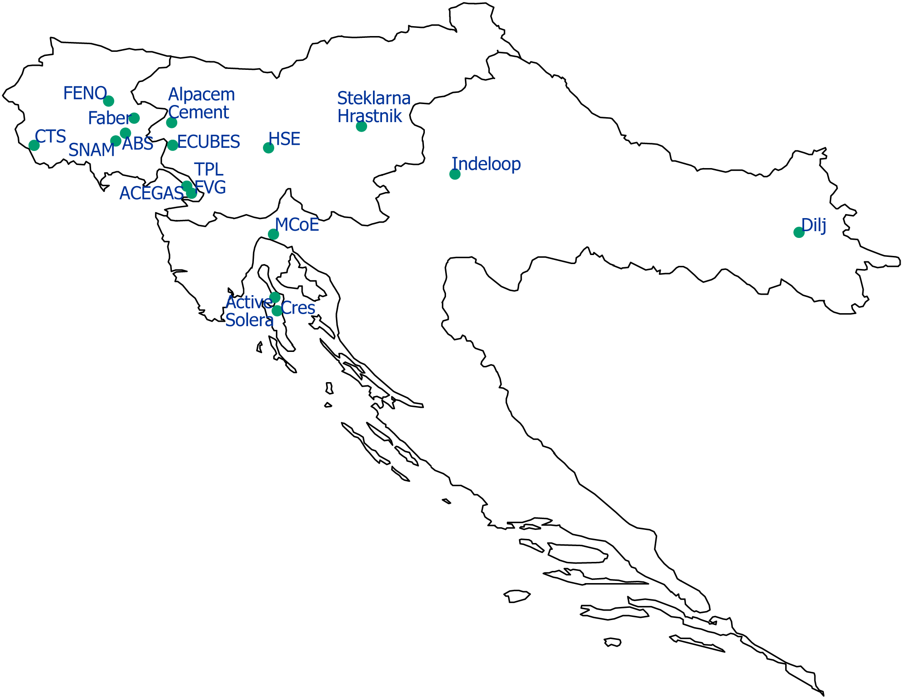
Testbed Projects
The project has activated 17 testbed applications in their related ecosystems, clustered in three main pillars – the hard-to-abate industries and the energy and transport sectors.
These act as real-life cases for piloting global hydrogen markets, moving from TRL 6 at the beginning to TRL 8 by the end of the project.
Four fuel cell applications in the energy and transport sectors will be demonstrated. Testbeds will then be scaled up to the industrial level as a replicable model, contributing to the decarbonisation of the three territories by harnessing renewables to improve system resilience, security of supply, and energy independence.
Map: Locations where the NAHV testbeds partners are seated

Slide 8
I. Hydrogen as a partial replacement for natural gas in a kiln of a roof tile producer Dilj, Vinkovci, Croatia
Testbed Leader: DILJ
Ciglarska 33, 32100 Vinkovci, Croatia
Director (or representative): Krešimir Vidaković (kresimir.izakovic@nexe.hr)
Objectives and Project Description
World’s first on-site hydrogen production installation within tunnel kilns for roof tile production.
Complete supply chain from production to consumption of green hydrogen.
Safely introduce the benefits of hydrogen to the local community.
Entire process is highly efficient, resulting in significant CO2 savings per invested €.
After successful implementation of the project, technology can be deployed in other factories in ownership of Dilj d.o.o., and any other tunnel kiln in roof tile and block brick production industry all over the world.
Key Metrics
Project must prove through industrial testing that it is possible to use hydrogen in the process of roof tile production with the same heat distribution and same quality of the final product.
After the project implementation we expect to reduce CO2 emissions for more than 20 % and energy consumption for more than 10 %.
PEM Electrolyser will be used for hydrogen production, yearly hydrogen production up to 315 t/year.
Total budget of the project is 45.067.500 euro and contains testing in kiln and hydrogen production, electricity production, grid connection and storage. The portion from NAHV amounts to 3.978.095,26 euro. For the project competition additional co-financing is needed.
Produced hydrogen will be used as replacement for natural gas, it will be blended from 20 % to 100 % with the natural gas.
Impact and Benefits
The project will enable Dilj to reduce CO2 emission, reduce energy consumption and dependency on the natural gas supply.
Dilj will position itself as one of the industry leaders of the green transition in roof tile production.
The project aims to demonstrate safe hydrogen usage to the local community.

Slide 9
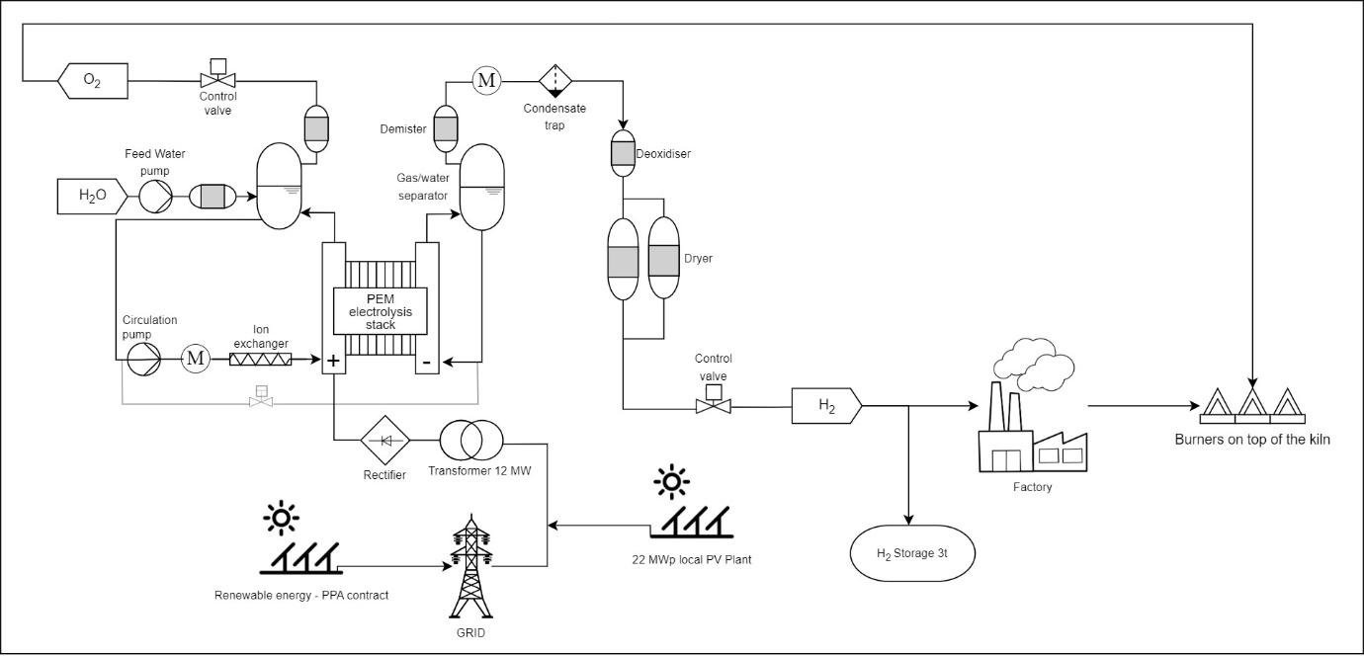
Production process scheme of the DILJ testbed

Slide 10
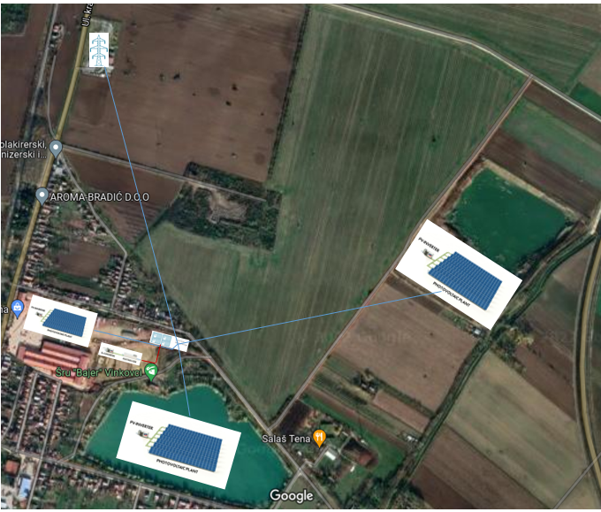
Current status, process highlights and main challenges at Dilj, Vinkovci
Current Status
Phase 1 of the project is ongoing, which includes:
pipeline drawings for hydrogen supply from trailer to the kiln preparation, technical discussion with burner suppliers, search for possible suppliers of hydrogen needed for the test to implement first phase of the project.
Challenges faced
Phase 1: Main obstacle in the Phase 1 of the project is securing uninterrupted quantities of hydrogen during the 5 - 10 days. For test it is necessary to ensure 780 kg of hydrogen per day. This is a challenging task for all contacted hydrogen suppliers.
Phase 2: Replacing natural gas with Hydrogen, will be financially viable only if we are able to maximize efficiency of hydrogen production, and reduce energy consumption. Possibility to use oxygen for kiln oxidization, and to reduce amount of air which we are impelling for burning process will help us to reduce overall energy consumption.
PEM Electrolyser used for hydrogen production will be used also for grid balancing to diminish price difference between electricity used for hydrogen with efficiency of 65 % and natural gas with CO2 emissions added.
Additional CAPEX and OPEX subsidy will be needed to enable switching from natural gas to hydrogen.
Progress Highlights
Through conversations with potential suppliers, we found out how difficult it is to find a reliable supplier of larger quantities of hydrogen and hydrogen equipment in general.
Future Plans
Phase 1 – testing of hydrogen on the kiln will be done till March 2025.
After results of Phase 1, we will continue with phase 2 of the project. In parallel with phase 1, electricity production and storage projects will be prepared, as the cheap electricity is the key for shifting from natural gas to hydrogen in hard to abate industries, until hydrogen pipelines are built.
Grid connection and RES production at Dilj, Vinkovci

Slide 11
II. Hydrogen utilisation in special steel production and treatment, ABS, Pozzuolo del Friuli, FVG, Italy
Testbed Leader: ABS (Acciaierie Bertoli Safau)
Via Buttrio 28, Pozzuolo del Friuli 33050, Italy
Director (or representative): Antonio Iaia
Project Description
Industrial validation and implementation of experimental hydrogen burners to transform steel ingot heat treatment furnaces (typically divided into four control zones fed by a total of eighteen 233kW burners) to achieve effective total decarbonisation, using carbon-free energy carriers such as renewable hydrogen either as a blend or as a total replacement for traditional fossil fuels. Continuous fine-tuning and testing of control equipment, measuring systems, burners, operational and safety practices, and maintenance up to the replacement of all existing burners in a 100% hydrogen furnace, to assess the impact on the treated steel of an atmosphere composed of water vapour as well as nitrogen and oxygen. Similarly, the impact on refractory materials in the furnace chamber will be assessed.

Slide 12
III. The scale-up of highly efficiency modular electromechanical compressor, SNAM, FVG, Italy
Testbed Leader: SNAM
Friuli-Venezia Giulia, Italy
Director (or representative): Andrea Antenucci
(andrea.antenucci@snam.it)
Project Description
The validation of an innovative H2 compressor at TRL 6-8 will be implemented. The project will improve the system CapEx from 7’700 €/kW to 5’600 €/kW, especially for HRS applications, and will test the production plant of green hydrogen in Torviscosa (Ud), in order to improve the carbon footprint of an new developed plant that produce green hydrogen from electrolysis process (4MW) with electrical energy supplied from co-developed renewable plant at site and to enter a new market where green hydrogen is used for mobility application and in the chemical and hard to abate industry. Notably, the innovative H2 compressor will target the achievement of the 2030 CHJU Strategic Research targets of 3 kWh/kg_H2– for 5/900 bar compression, as well as a higher reliability by targeting a Mean Time Between Failure (MTBF) of 40’000 hours.

Slide 13
IV. Blending mix usage in rolling mill pre-heating furnace for hard to abate industrial application, FENO, FVG, Italy
Testbed Leader: FENO (Ferriere Nord)
Friuli-Venezia Giulia, Italy
Director (or representative): Loris Bianco
Project Description
Industrial validation and implementation, in cooperation with the equipment supplier, of new burners(and relative piping, blending, and control systems) able to use renewable H2 blending with natural gas in reheating furnace of rebars rolling mills, to keep the billets at high temperature (typically 1,100-1,200°C) before rolling, to improve steel ductility, or to promote the formation of a specific microstructure. The prototypal reheating furnace will have to ensure at least the same level of safety during operation and quality of the product after rolling, surface quality in terms of scale formation, scale adhesion, and decarburization. Moreover, also air emissions will be verified in terms of CO2 reduction, and a particular focus will be devoted to NOX.
Considering the large consumption of the burners around 19 MSm3/year of Natural Gas, systems able to work in blends of H2/Natural Gas, up to 50% H2, will lead to a consequent reduction of the emission of CO2, and other GHG of about 10.000 ton/year.

Slide 14
V. H2 production for cement industry decarbonisation, Alpacem Cement, Anhovo, Slovenia
Testbed Leader: Alpacem Cement
Anhovo 1, Anhovo, 5210 Deskle, Slovenia
Director (or representative): Sašo Seljak (saso.seljak@alpacem.si)
Objectives and Project Description
This testbed project aims to build a containerized electrolyser ranging from 0.5 to 1 MW, equipped with necessary storage and connections to utilize the produced hydrogen in the transport sector. The current storage and filling infrastructure will be upgraded or replaced as part of this project. One hydrogen truck will be purchased for cement transportation. Knowhow on producing renewable hydrogen at a competitive price tailored to the energy profile and needs of the cement plant will be gained.
A feasibility study will explore using hydrogen directly in production and scaling systems, including battery integration, to maximize renewable energy use and support grid balancing.
The goal is to reduce the carbon footprint by replacing fossil fuels in the kiln and converting captured CO2 into methane or methanol.
System sizing and component selection will align with the goal of producing 50 tons of green hydrogen annually, guided by economic and technical analyses. All necessary permits will be obtained before installation. The hydrogen-powered truck will be evaluated based on technical and economic criteria, and relevant legislation will be reviewed. The project will provide data to support the broader adoption of hydrogen fuel in transportation, reducing the end product's carbon footprint.
Total Budget
The total project budget is 5.525.000 euro, with NAHV providing a grant of 500,000 euro.
Key Metrics
The testbed project aims to produce 50 tons of hydrogen annually.
The produced hydrogen will primarily fuel hydrogen truck(s) for cement delivery. Any surplus hydrogen will be supplied to other end-users within the NAHV network or made available for public filling stations.
Impact and Benefits
Established production will represent a source of hydrogen in west part of Slovenia. Although it will be used for Alpacem transportation task it will be also available for other NAHV partners and for potential public users in future with its (public) filling station (municipal buses, cars, etc.).
The use of hydrogen in transport will contribute to significant reductions in CO2 emissions and thus to the EU's goal of zero emissions in the field of transport.

Slide 15
Current status, process highlights and main challenges at Alpacem Cement, Anhovo (Slovenia)
Status
Economically technical study of WP 3.5 is done. This includes the sizing of necessary equipment, capital expenditure (CAPEX) and operational expenditure (OPEX) study for different scenarios.
Identifying and evaluating potential suppliers for necessary components and technologies is done.
Challenges
The cost of producing hydrogen remains high, posing a significant economic challenge.
Uncertain national legislation complicates the need for permits, particularly construction permits, which affects project timelines and planning.
Securing the necessary subsidies to close the financial structure for the project remains a challenge, with no additional subsidies secured thus far, and an unsuccessful bid in one public tender.
Progress highlights
Participation in a round table discussion as part of the AMETHyST project, organised by the Energy and Climate Agency for Podravje, focused on local green hydrogen ecosystems and their role in the Alpine region's transition to a post-carbon lifestyle
Attendance the conference "Hydrogen as a Key Factor in the Green Transition: Challenges and Opportunities" organised by the Ministry of the Environment, Climate, and Energy in June
Engaging in active discussions with the Ministry of the Environment, Climate, and Energy regarding potential national subsidies and the process of obtaining construction permits. These discussions are crucial for securing financial support and navigating the legal requirements for project implementation.
Future Plans
Securing the necessary subsidies through public tenders to ensure a closed financial structure for the project, navigating the legal and bureaucratic processes to obtain the required construction permits and completing the selection of equipment suppliers to ensure all necessary components and technologies are available are in the focus.
Sandi Gorišek presenting at the "Hydrogen as a Key Factor in the Green Transition: Challenges and Opportunities" conference organized by the Ministry of the Environment, Climate, and Energy in June

Slide 16
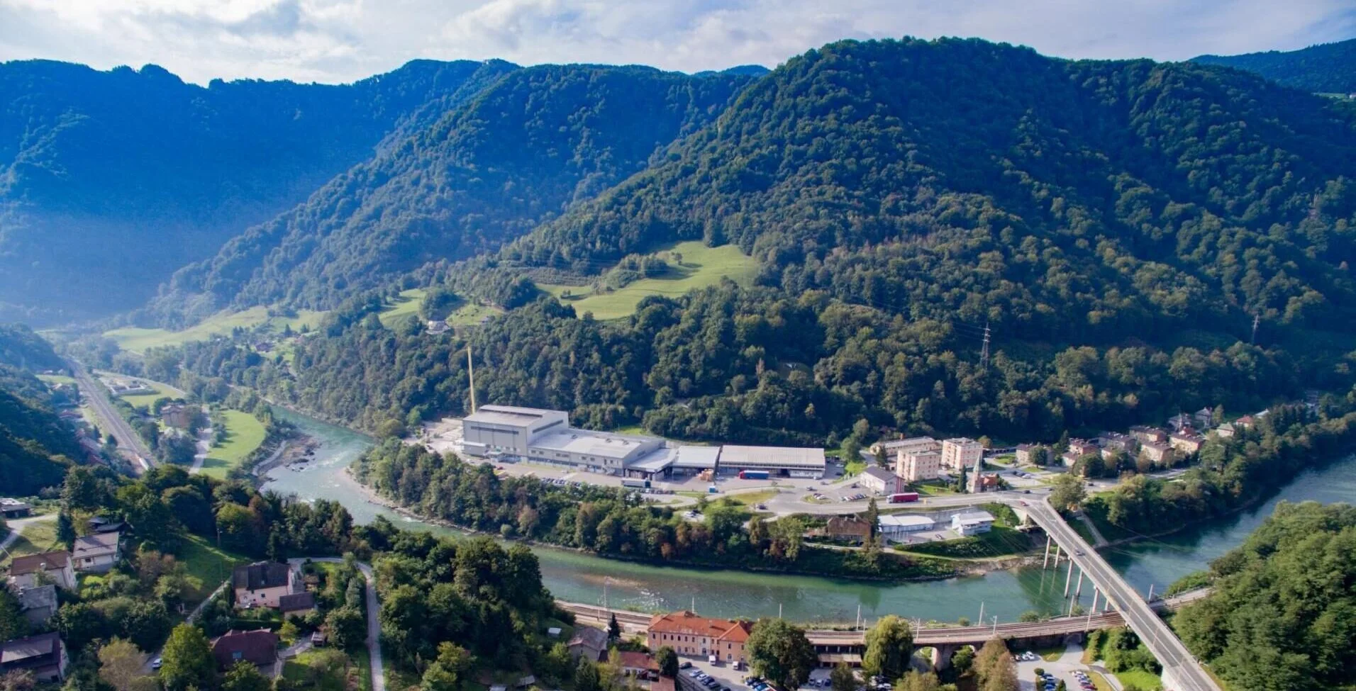
VI. Efficient utilization of WE system in the glass industry, Steklarna Hrastnik, Slovenia
Testbed Leader: Steklarna Hrastnik
Cesta 1. maja 14, 1430 Hrastnik, Slovenia
Director (or representative): Tilen Sever
Project Description
Hrastnik1860, as a project partner, will implement a hydrogen pilot for the glass industry by integrating a large-scale PEM water electrolyser and hydrogen storage into an oxyfuel glass furnace. The system will utilize both hydrogen and oxygen generated by electrolysis, enhancing the energy efficiency of the furnace and driving much-needed decarbonization of the glass melting process. This initiative aims to establish a sustainable and reliable supply of renewable energy, positively impacting the industry’s environmental footprint.
Impact and Benefits
A 3 MW water electrolyser system will be integrated with the existing 120 MTPD oxyfuel furnace. Both hydrogen and oxygen will be utilized to improve overall energy efficiency. Partially powered by renewable energy sources (RES), the system will feature advanced control mechanisms and mid-pressure hydrogen storage to manage fluctuations in supply and optimize performance. A cutting-edge hydrogen combustion system will enable flexible intake of hydrogen and oxygen into the furnace, supporting decarbonization efforts.
HRASTNIK1860, glass works seated in Hrastnik, Slovenia is a protagonist in the hard-to-abate sector.

Slide 17
VII. Clean hydrogen from non recyclable waste through SMO (Solaire-MicroOndes) solar process, Active Solera, Cres, Croatia
Testbed Leader: Active Solera
Cres, Croatia
Director (or representative): Ivana Chaux-Jukic
Project Description
Development and optimization of a patented SMO Solar Process, an energy autonomous waste processor using exclusively solar thermal energy to transform non-recyclable carbon-based waste into competitively priced Clean Hydrogen and Energy, together with Carbon Products. After construction, the thermolyser and gasifier will be tested and validated independently in the mechanical workshop, then modules will be connected in a complete SMO unit and tested. The Artificial Intelligence controlling system will be implemented to monitor the process, executing automated adjustments to ensure optimal operations. The completed SMO unit will be tested with local Croatian inputs, on the island of Cres prior to site commissioning. H2 purity will be analysed. Measured KPIs will be compared to projected yields.
In a second phase, the site will be operating, delivering clean Hydrogen converted to electricity (by using hydrogen engines and experimental fuel cell stationary power genset) directly injected to the grid. Operational phase will be monitored assessing production KPIs, logistic functionalities and human resources availability.

Slide 18
VIII. H2 production through industrial symbiosis and asset enhancement, ACEGAS, Trieste, FVG, Italy
Testbed Leader: ACEGAS
Via del Teatro, 5, Trieste, Italy
Director (or representative): Giacomini Massimo (mgiacomini@acegasapsamga.it)
Project Description
An electrolyser prototype will produce renewable hydrogen. The hydrogen production plant will be electrically powered by renewable energy purchased from RES plants and produced by a photovoltaic field. In a perspective of industrial symbiosis, the hydrogen production plant will use the purging of the cooling towers of the waste-to-energy plant. The hydrogen produced will be stored and made available to users, including the logistics sector and the local public transport service.
Key Metrics
Electrolyser power: 5 Mwe
Hydrogen production: 370 t/y
The hydrogen produced will be made available to the logistic the sector and the local public transport service.
The total budget of the project has just been updated to 19,3 million euros.
Impact and Benefits
The goal is to increase the overall efficiency of the developed system, reduce the environmental impact of the process and thus develop a scalable solution.
Current Status
The initiative aimed at building the hydrogen production plant has completed the first phase of technical and economic feasibility design.
Last June, the request for authorization to build the plant was formalized, currently under the jurisdiction of the FVG Region; it is expected to be completed by the end of 2024.
The process for purchasing the electrolyser is underway, with a procedure involving over 15 European and non-European suppliers; the purchase contract is expected to be formalized by next October.

Slide 19
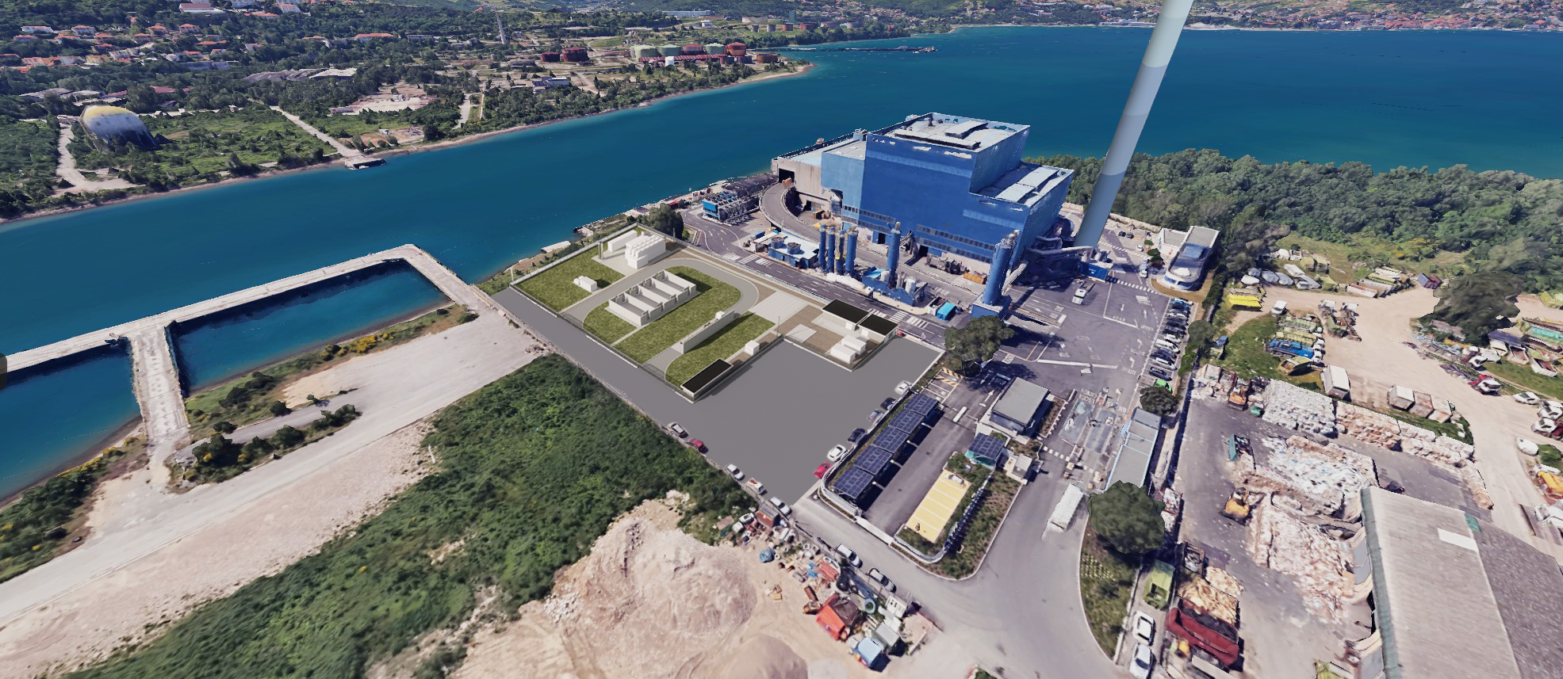
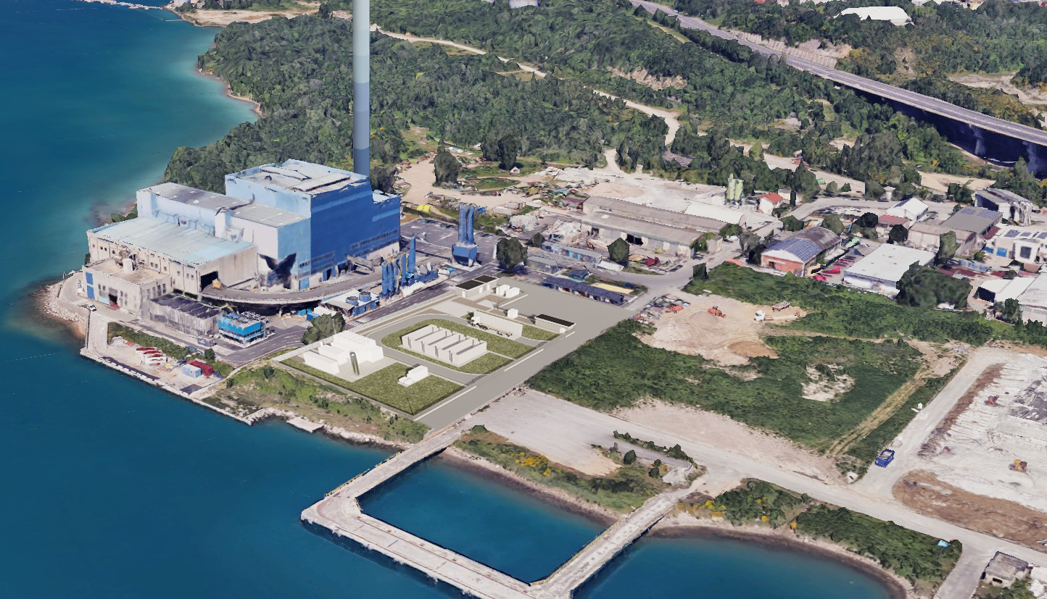
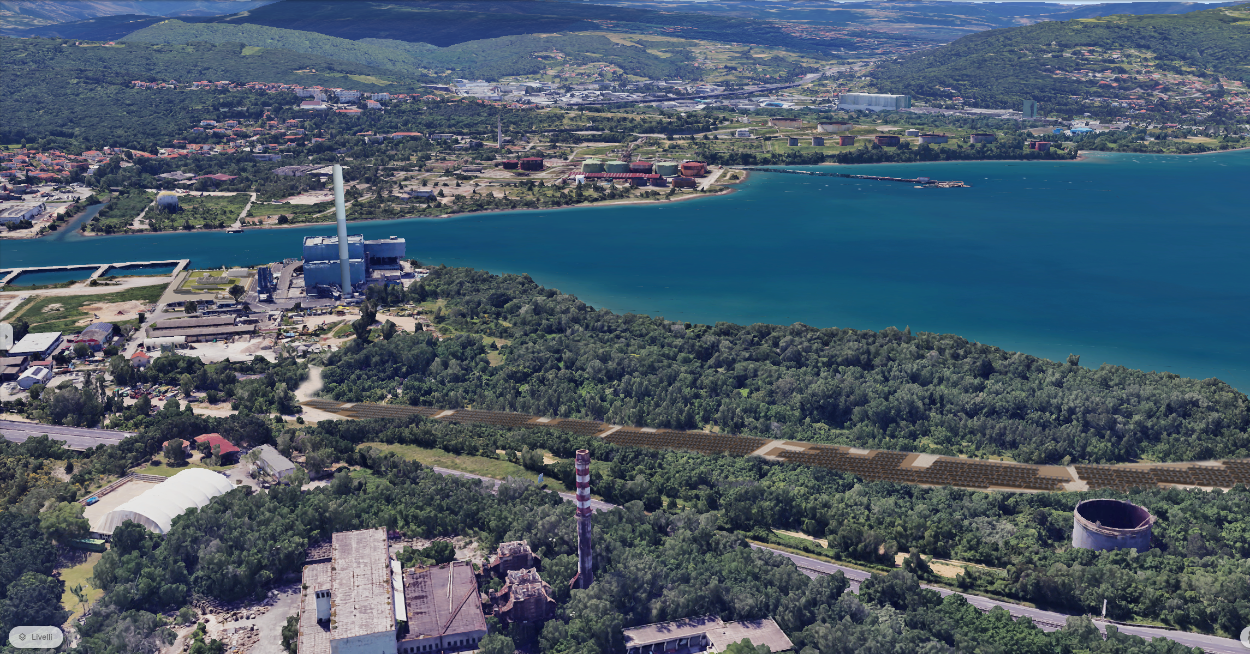
H2 production through industrial symbiosis and asset enhancement, ACEGAS, Trieste, FVG, Italy
Progress Highlights
this type of plant, given the novelty they represent, requires a cooperative approach that pools the skills of the greatest number of parties involved. In our case, we involved parties such as the University of Trieste and the Bruno Kessler Foundation to identify the optimal conditions for the project and the best partners to involve in the implementation phase.
The collaboration of the institutions was also extremely important to define the authorization process and the involvement of the territory; in this context, the collaboration we found in the FVG Region was fundamental.
Future Plans
The tender for the construction of the hydrogen production platform, i.e. all the civil and electromechanical works necessary to host the supply of the electrolyser and to make the production plant operational, should start in the second half of 2024. The start of the works is instead scheduled for the first half of 2025.
Images of the production plant in Trieste

Slide 20
IX. Assessment of the suitability of the natural gas distribution network for the transport of hydrogen mixtures, FVG, Italy
Testbed Leader: ACEGAS
Friuli-Venezia Giulia, Italy
Director (or representative): Maria Mazzurco
Project Description
To obtain the "Technological Qualification" (TQ) of the existing distribution network, a testbed application will be conducted in order to evaluate the use of ACEGAS own methane gas distribution network assets for the injection of increasing% of hydrogen, beyond the current regulatory limits (2%), as well as the hydrogen storage in case of peaks production. The technical feasibility of an increase in the maximum permissible pressures will be evaluated, while continuing to ensure compliance with the highest safety and environmental protection standards, according to the innovative "Performance Based Design Method" of ASME B31.12: 2019.

Slide 21
X. H2 by gasification of organic material for small microgrid in the industry area, Indeloop, Zagreb, Croatia
Testbed Leader: Indeloop
Zagreb, Croatia
Director (or representative): Danica Maljković
Project Description
The project involves the construction of a 2 MW photovoltaic (PV) plant coupled with a 430-kW proton exchange membrane (PEM) electrolyser. This system will facilitate the daily production of approximately 200 kg of hydrogen. The plant uses thermal conversion (gasification) to turn organic material, such as non-recyclable plastics, sludge, and textiles, into hydrogen and carbon black. It consists of three main systems: thermal conversion, cleaning and cooling, and hydrogen preparation. The plant is also capable of processing wastewater sludge. The estimated yearly production of hydrogen is 80 tonnes. Additionally, the project plans to install 200 kW fuel cells along with hydrogen storage. The electricity produced from the 2 MW PV system will be used to power the PEM electrolyser. The stored hydrogen will also be used
in fuel cells for electricity production when necessary, creating a small microgrid within an industrial area in Zagreb, Croatia.
Key Metrics
Technology: Gasification, PV system, PEM electrolyser, and fuel cells. Hydrogen Production: 200 kg per day, 80 tonnes per year. Plant Capacity: 2 MW PV system, 430 kW PEM electrolyser, and 200 kW fuel cells.
Impact and Benefits
The testbed project will create a sustainable energy source for the industrial area, reducing reliance on conventional energy grids. The gasification plant tackles the problem of non-recyclable organic waste while providing clean hydrogen for energy use. The stored hydrogen can be used for fuel cell electricity generation, enabling greater energy autonomy in the local industry.
Current Status
The plant’s construction is underway, with the PV and PEM systems being installed. No specific challenges have been reported at this stage. Future milestones include commissioning the PEM electrolyser and completing hydrogen storage installation.
Progress Highlights
The project has demonstrated how waste2energy plants can help industries transition toward self-sufficiency while managing organic waste sustainably. Early successes show that the model could be replicated in other industrial settings across Europe, enhancing local energy resilience.

Slide 22
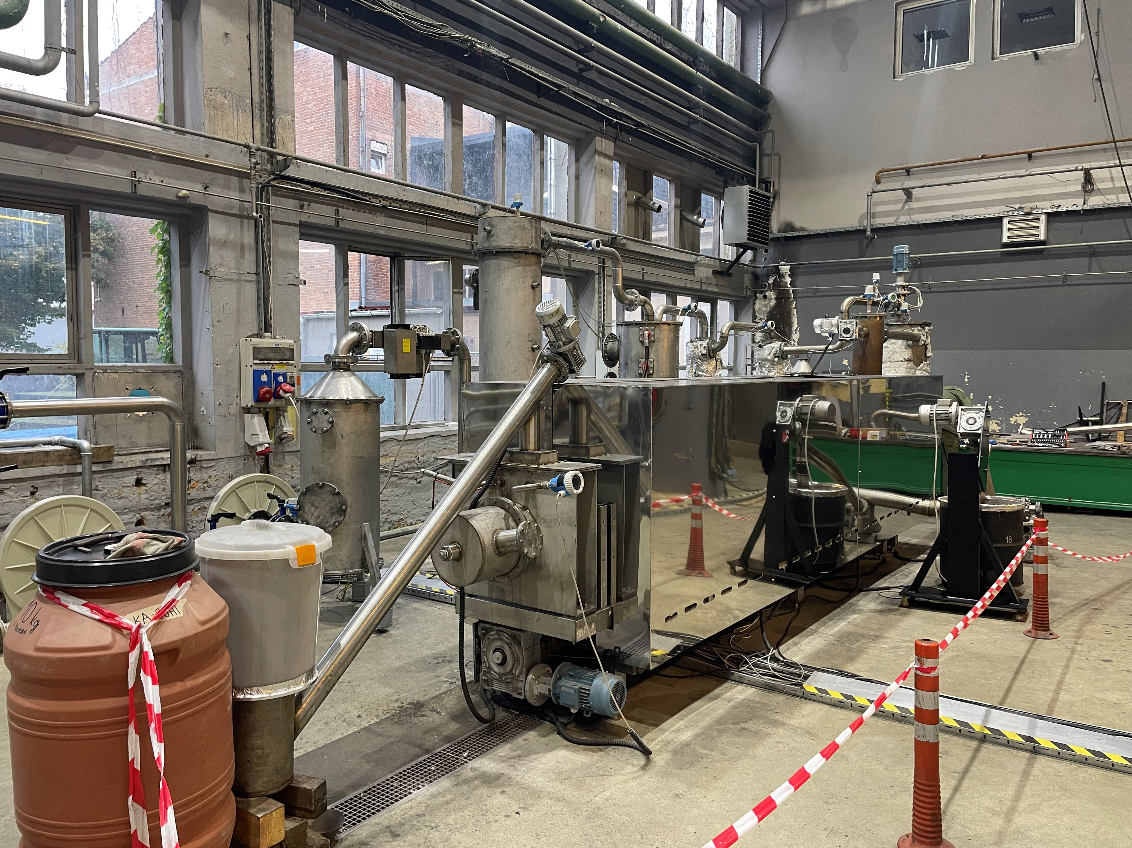
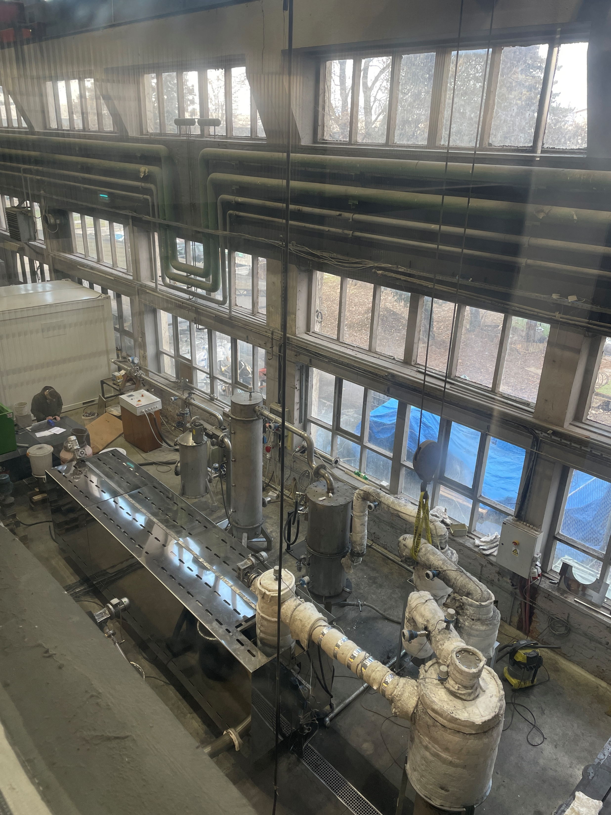
H2 by gasification of organic material for small microgrid in the industry area, Indeloop, Zagreb, Croatia
Future Plans
Upcoming steps include completing the hydrogen storage system, integrating the 200 kW fuel cells, and operationalizing the microgrid. The project aims to contribute to the region's broader hydrogen economy, with potential expansions based on the plant’s performance.

Slide 23
XI. Hydrogen ecosystem solutions and production for emerging markets, HSE, Ljubljana (Slovenia)
Testbed Leader: HSE
Koprska ulica 92, 1000 Ljubljana, Slovenia
Director (or representative): Jerneja Sedlar (jerneja.sedlar@hse.si)
Project Description
HSE is currently developing a renewable hydrogen production and distribution facility. The testbed aims to convert surplus energy from intermittent, renewable sources into renewable hydrogen. The hydrogen will be utilised as a renewable energy source in the cement and glass industries, local transport, and electricity production.
The testbed includes a PEM electrolyser, a compressor station, a hydrogen refuelling station for cars and buses, and a hydrogen transport vessel refuelling station for four transport trailers.
The facility will solely rely on renewable energy sources, establishing it as the first commercial size electrolysis plant in Slovenia and the pioneering renewable hydrogen production facility in the region.
Key Metrics
Our testbed is split into two phases.
In the first phase the plan is to deploy a 3 MW PEM electrolyser, with the goal to produce 300 tons of renewable hydrogen per year. This setup includes two 150 kW compressors capable of compressing hydrogen up to 950 bar. The hydrogen will be distributed to a 350 or 700 bar dispenser for buses and cars or to one of four dispensers with variable pressure settings for transport vessels, compatible with road, rail, and water transport. There will be modular stationary storage at 500 bars (initially 500 kg) and 900 bars (initially 40 kg) for use at the refuelling station.
The first-phase budget is approximately 15.000.000 euros, with NAHV covering 30%. The start of commercial operations is planned for Q2 2026.
In the second phase, the plan is to deploy an up to 30 MW electrolyser system to increase our production capacity from 300 to 3.000 tonnes per year. The plan is to expand our transport and
distribution facility based on demand and may also incorporate infrastructure for injecting renewable hydrogen into the existing gas pipeline.

Slide 24
Impacts, current status, process highlights and main challenges for hydrogen ecosystem solutions and production for emerging markets, HSE, Ljubljana, Slovenia
Current Status
The municipality confirmed the spatial planning for the first phase of the project, and the responsible ministry formally denied the need for an environmental study, shortening our timeline by about a year.
The documentation necessary for the building permit application is being prepared with the plan to apply for the permit by the end of the summer.
In the meantime, the spatial planning process has started for the second phase of the project and there is a new spatial plan in preparation, to be confirmed by the municipality.
Future Plans
Our main focus now lies in getting the building permit for the first phase of the project and finishing the spatial planning process for the second phase of the project.
The focus will then be on launching a public tender for the procurement of the needed equipment for the first phase of the project and implementing the system into the vast energy production portfolio.
Efforts are being made to identify the possible hydrogen offtakers in Slovenia and in the region in general. After all, 20% of the renewable hydrogen must be distributed across the border.
Impact and Benefits
The hydrogen plant will greatly improve the utilisation factor of our ever-growing intermittent power generation portfolio, allowing renewables to keep running while producing hydrogen using that electricity instead of shutting them off when the market deteriorates. The hydrogen will be used as fuel by the neighbouring municipality, which is planning to switch to hydrogen for all their public transport buses, greatly improving their carbon footprint.
It will be used as a showcase for the hydrogen market in Slovenia, being the first car and bus hydrogen refuelling station in the country.
The hydrogen will be available for use as a coolant for the generators via the existing pipeline in the power plant. It will be tested as an energy source for the two hydrogen ready gas turbines that TEŠ has installed. The electrolyser will utilise a heat recovery system, so we can use the excess heat in our district heating system, providing up to 1 MW of heat to the two neighbouring municipalities.
Progress Highlights
One of the significant milestones of the project was the official letter from the Ministry of natural resources and spatial planning, denying the need for an environmental study for these types of facilities in Slovenia.
As the project progresses, more ideas and opportunities on the use of renewable hydrogen as a renewable energy source are emerging.

Slide 25
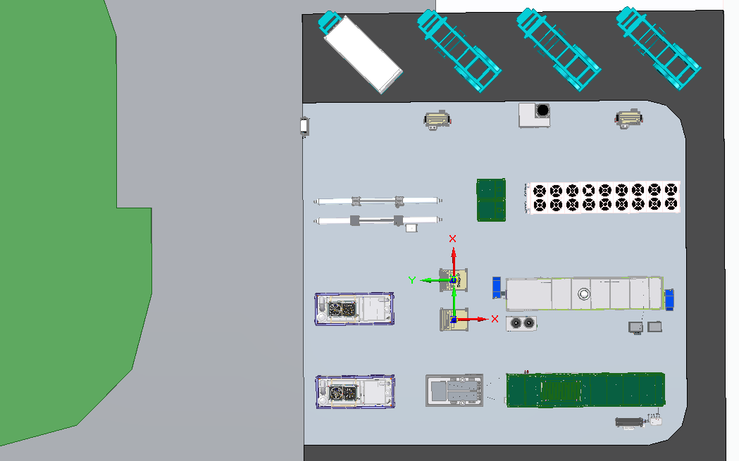
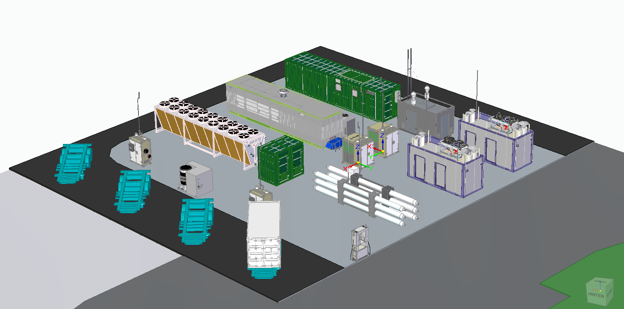
Hydrogen ecosystem solutions and production for emerging markets, HSE, Ljubljana, Slovenia
Potential plant layouts, subject to change as the project advances.

Slide 26
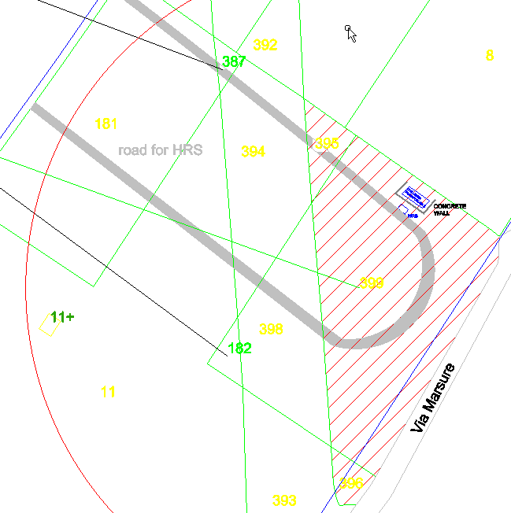
XII. Integrated hydroelectric and HFC power station for retail distribution of hydrogen, CTS, Brugnera, Italy
Testbed Leader: Clean Technology Systems H2
Brugnera (PN) – Viale Lino Zanussi 1 – 33070, Italy
Director (or representative): Federica Zagarella
(f.zagarella@ctsh2.com)
Project Description
The testbed focuses on validating and implementing a small, potentially distributed hydrogen refuelling station with onsite renewable H2 production. The station will produce up to 2 tons of renewable H2 annually, powered by either a small hydroelectric station or a photovoltaic plant. The H2 will be produced using an AEM electrolyser (35 bar max pressure), ensuring 99.999% purity, and stored in a 2324-liter system. The electrolyser type will depend on the power source: AEM for variable solar power (60 kW) and AWE for continuous solar power (1 MW). Rainwater collected from the cabinet roof will be used in the electrolytic process. After compression to 300 bar, H2 will be stored and used to refuel vehicles according to SAEJ2601: 2010 standards, reaching up to 350 bar in two phases. Additionally, a Fuel Cell (HFC) will provide up to 5kW of energy for small devices, lighting, or self-supplying the station. An industrial research activity will also focus on developing a high-pressure demo electrolyser that supplies H2 at 350 bar without compression.
Impact and Benefits
CTS H2 S.r.l. will develop the first demo modular and transportable HRS powered by renewable energy source, in circular economy regime, and in cogeneration state, serving Fuel Cell Electric Vehicles (FCEVs) along the north Adriatic corridor. The HRS will be located in a “plug and play” container that can be moved by truck transport; depending on the power plant size, more modular containers can be moved and installed.
Once fully operational, the system will be able to fuel buses for running 50 thousand kilometres yearly with a production of 6000kg of hydrogen implying the possibility to use at the same time 30000 kW of thermal energy and 7000 kW of electricity.
The system will be able to sequestrate 56.600 kg of CO2 and release 30000 Nmc of oxygen, corresponding to the effect of a 1.1 hectare of forest per year.
Map of the potential location of the testbed

Slide 27
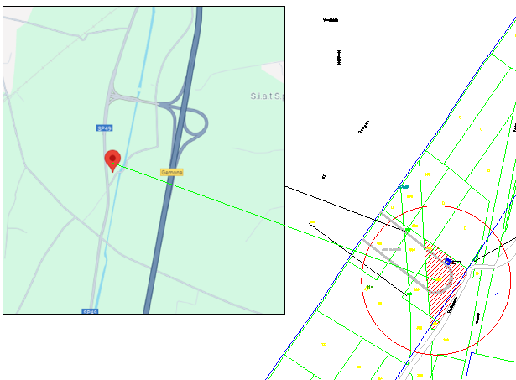
Benefits and key metrics for the integrated hydroelectric and HFC power station of CTS, Brugnera, Italy
Impact and Benefits continued
Thanks to the fuel cell, each kWh of electrical energy produced from hydrogen will depurate 250 litres of air per hour.
Key Metrics
AEM or SPECIAL AWE electrolyser (35 bar maximum pressure) with 99,999% purity;
inertial buffer tank;
2324 litres cylinder rack as storage tank;
Filling process (compression to 350 bar) in 2 phases;
Fuel Cell (5kW);
Production of carrier to fuel buses for potentially running 50’000 kilometres;
A small innovative AES electrolyser on company test bench for the H2 production in high pressure.
Map of the potential testbed location proximity to highway (site coordination: N 46.246799, E 13.095188 - source: Google Maps).
See also the detail on the previous page

Slide 28
Development of integrated hydroelectric and HFC power station for small distribution hydrogen refuelling stations, CTS, Brugnera, Italy
Current Status
The testbed project is in the preliminary design phase. CTS H2 S.r.l. is in discussions with potential stakeholders to identify a suitable location and renewable energy source (RES). However, progress is slow due to several challenges: finding stakeholders to invest in fuel cell electric vehicles (FCEVs), identifying a strategic site for hydrogen-integrated heavy vehicles with expansion potential, locating a site near renewable plants (the initial hydroelectric plant has logistical and authorization issues), and securing further investments and a suitable site for the hydrogen refuelling station (HRS). Additionally, the project faces budget reductions despite significant efforts to engage stakeholders.
Progress Highlights
This project builds on 18 years of experience in the hydrogen sector by CTS H2. The goal is to create an innovative, modular, and transportable hydrogen refueling station (HRS) that efficiently produces green hydrogen using renewable energy sources (RES) through electrolysis.
Key Features
Modularity: The HRS will be made of easy-to-assemble modules in mini-containers, allowing for rapid installation and flexible configurations.
Transportability: The modules will be designed for easy movement on standard vehicles, even to remote locations.
Efficiency: The system will maximize energy efficiency, from hydrogen production to storage and distribution, using IoT technologies to optimize self-consumption and reduce O&M costs.
Green Hydrogen: 100% of the hydrogen produced will come from renewable sources like solar or wind power.
Cogeneration: The system can be equipped for cogeneration, producing both electric and thermal energy by using waste heat from electrolysis.
Power-to-Power: The system can operate in power-to-power mode, using hydrogen-generated electricity for auxiliary functions and grid balancing.
High-Pressure Storage: Hydrogen will be stored in high-pressure tanks for greater energy density and autonomy.
New Electrolysis Technology: A new high-efficiency electrolysis technology will be tested to produce high-pressure hydrogen directly, eliminating the need for a compressor, reducing costs, and extending system life.
This testbed will provide an innovative, sustainable, and flexible solution for producing and distributing green hydrogen for heavy vehicles, suitable for both private and public HRSs.
Future Plans
Once clarified the budget situation and obtained and extra financing, the testbed implementation could proceed.

Slide 29
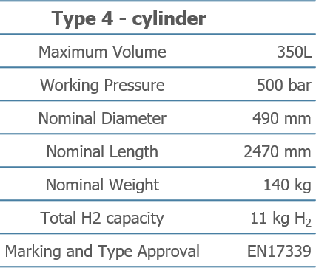
XIII. Development of Hydrogen storage system for distribution, Faber, Cividale del Friuli (UD), Italy
Testbed Leader: FABER
Via dell’Industria, 64 33043 Cividale del Friuli (UD), Italy
Director (or representative): Alberto Agnoletti
Project Description
A new H2 storage composite vessel prototype has been industrially validated, capable of holding over 300 litres of water. The prototype is being implemented on a fully automated line to produce high-pressure gas cylinders at a mass production scale of 10,000 cylinders per year, providing an optimal compromise in terms of performance and economics. The increase in operating pressure to at least 500 bar and the advanced use of composite materials, and based on regulatory/normative documents, for an increment in the gravimetric efficiency of the cylinders to over 5% will make it possible to create vehicles capable of reaching a payload of over 1.2 tones of hydrogen.
Key Metrics
Current Status
The project has made significant progress in various areas, including sourcing diverse materials for liner, resin, and carbon fibre components. Initial testing phases have started, with tests already underway. Critical evaluations, such as permeation and ageing tests on liner materials, are still in progress.
The project is also progressing through the design and development stages for the carbon winding, with detailed simulations being executed to determine optimal geometric configurations for enhanced efficiency and performance. This phase is crucial for meeting project requirements.
The material selection approach, testing, and simulation efforts demonstrate the project's commitment to high-performance components.
Impact and Benefits
The testbed project aims to significantly impact the transport sector by providing a sustainable and efficient solution for hydrogen transportation. This will support the decarbonization projects contributing to the EU's green transition goals.

Slide 30
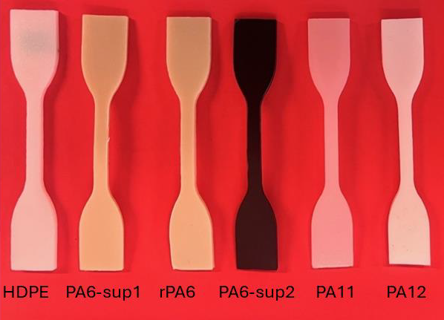
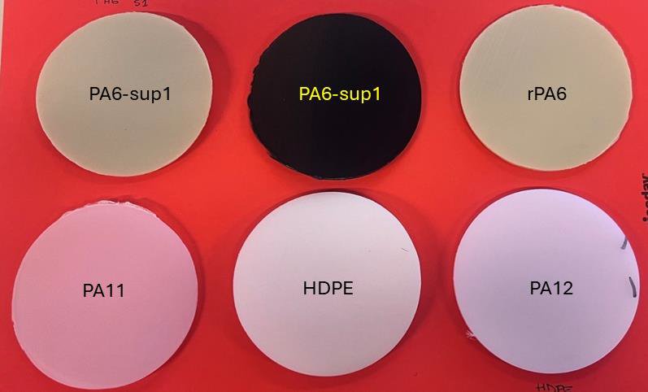
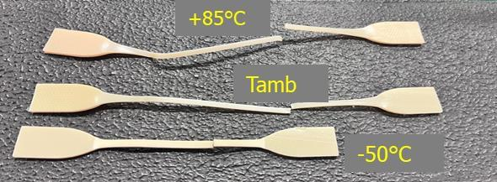
Future plans for the development of Hydrogen storage system for distribution, Faber, Cividale del Friuli (UD), Italy
Future Plans
The immediate next steps involve completing the ongoing material tests and further refining the study of the carbon winding. Following the successful completion of these two operations, the project will proceed with the fabrication of the initial prototypes.
These prototypes will undergo a thorough evaluation to determine the specific tests to be conducted. If the results of these preliminary tests are positive, additional prototypes will be produced to undergo the comprehensive testing required by the EN17339 standard.
Upon successful fine-tuning of the cylinders, the project will then focus on optimizing the production process. This optimization phase will ensure that the manufacturing workflow is efficient, cost-effective, and capable of meeting the high-quality standards established during the development and testing phases.
Visual Representation
The following pictures show some aspects of the work carried out for the selection of the materials.
Tests have been conducted on:
6 materials for the liner
3 carbon fibre types for composite reinforcement
4 resin systems for composite matrix
Furthermore, several liner production campaigns were analysed to define the optimal parameters for the blow moulding process of the different materials
Dumbbell-shaped specimens of studied materials
Example of PA6 samples after tensile test at different temperature conditions
Disc-shape specimens of studied materials

Slide 31
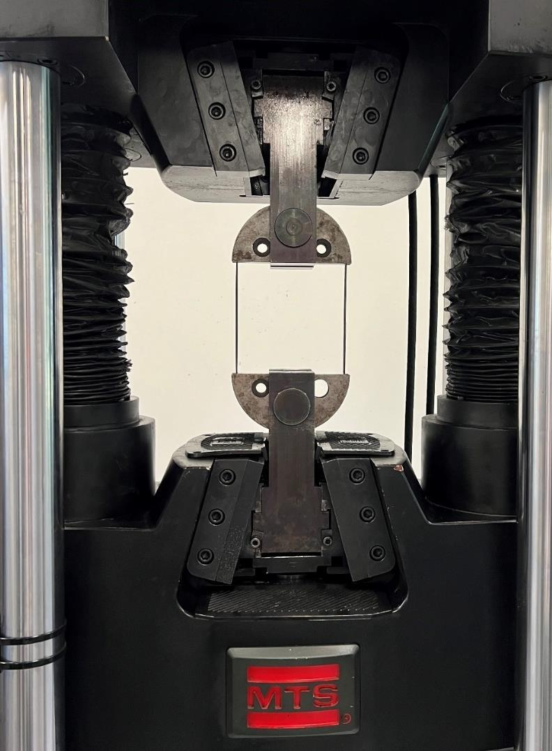
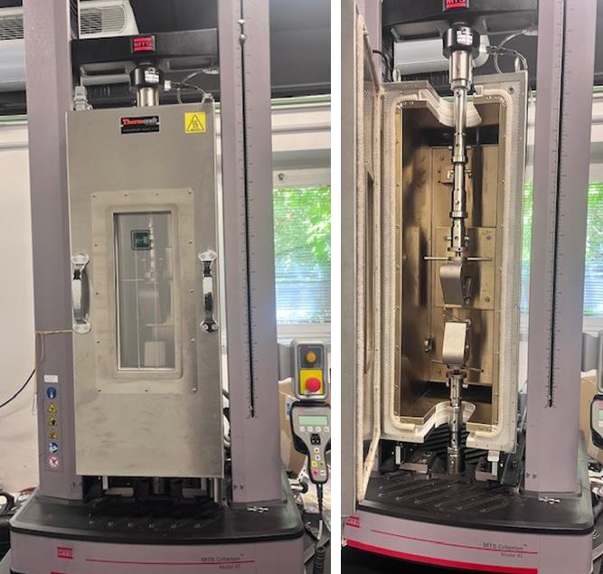
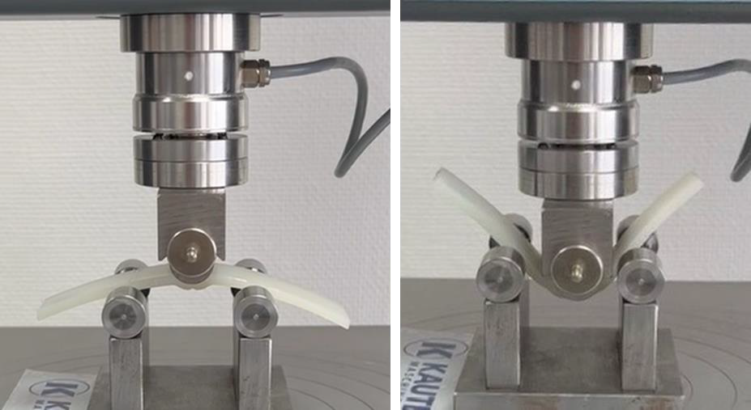
Development of Hydrogen storage system for distribution, Faber, Cividale del Friuli (UD), Italy
Example of bending test phases on a pinch-off sample of a PA11 liner after blow moulding production
Tensile testing apparatus with climatic chamber
Composite ring during tensile test

Slide 32
XIV. Hydrogen propulsion 4 vessels & maritime infrastructure in the Adriatic, MCoE, Rijeka, Croatia
Testbed Leader: Maritime Center of Excellence
Rijeka, Croatia
Director (or representative): Damir Opsenica
Project Description
The innovative technology of green vessel powertrain will be demonstrated by the delivery of hydrogen-powered pilot vessel. Conceptual design and optimization will be performed in three main aspects: 1) renewable hydrogen propulsion, focussing on performance, safety, certification and supporting value chain infrastructure; 2) power management and control using advanced digital technologies coupled with build-up of the new digital data model; 3) extensive sea trials and data collection/operational performance optimization; 4) collection of know-how, lessons learned and preparation of road map for future commercialization.
More in detail the following activities will be performed:
Hydrogen propulsion vessel conceptual design, including screening of existing Adriatic commercial fleet, data collection and evaluation of ship operating profiles, propulsion and power management systems, emission performance and existing port infrastructure supporting full supply chain, hydrogen technology value chain assessment, technology solutions assessment and value proposition.
Retrofit ship design and engineering, including complete engineering for basic and detailed design, safety and operating performance analysis and assessment, preparation of certification and class documents, liaison with certifying authorities and definition of supporting port infrastructure and complete fuel supply chain.
Retrofit ship digital technologies development, including analysis of digital twin solution for hydrogen powertrains, development of digital technologies (digital signal processing, big data and artificial intelligence-based models for powertrain process optimization and new generation of power management, all of which is relevant for greener operations of existing fleet), sensor system secure
networking and integration, development of digital twin for the complete retrofitted system and equipment and control system testing on testbed prior to installation.
Pilot project – shipyard retrofit activities, including Pilot vessel retrofit preparation (engineering and activities for removal of existing powertrain and controls), Pilot vessel retrofit execution (vessel preparation and installation of hydrogen propulsion powertrain and controls), Pilot vessel commissioning and sea trials with monitoring and optimization of the complete process.
Risk assessment relevant for the complete retrofit project.
Monitoring and follow-up after completion of the trial.

Slide 33
XV. Hydrogen for the public bus transport in Gorizia, Trieste Trasporti, Trieste, Italy
Testbed Leader: TPL FVG
Via dei Lavoratori, 2, 34144 Trieste TS, Italy
Partner: APT Gorizia
Director (or representative): Giuseppe Zottis (giuseppe.zottis@tplfvg.it)
Project Description
The project concerns the ecological transition of part of the TPLFVG fleet from diesel to hydrogen power. Trieste Trasporti, will use the hydrogen produced by the new AcegasApsAmga plant and, therefore, will build the storage and distribution plant. It is planned to refuel up to 10 buses by installing the refuelling system consisting of the following facilities: storage, chiller (cooling), compressor and two refuelling lines.
Key Metrics
An investment of 3.245.000 euros is estimated for the realization of the project.
Trieste Trasporti will also need to cover the costs for the purchase of 10 hydrogen buses, which has been estimated at 7,000,000 euros.
Impact and Benefits
The ecological transition project will have important consequences in the entire fleet management activity, which will see logistical, and maintenance activities change, and safety procedures will also have to be changed.
Current Status
Site inspections have been conducted on a potential area for the construction of the storage and refuelling infrastructure. Additionally, contacts have been made with AcegasApsAmga, which will handle the hydrogen supply.
Future Plans
The next steps involve identifying and subsequently purchasing the land for the construction of the hydrogen storage facility and the bus refuelling station. Once the area has been identified, the authorization procedures must be completed, followed by the drafting of an executive project to be presented during the tender phase.

Slide 34
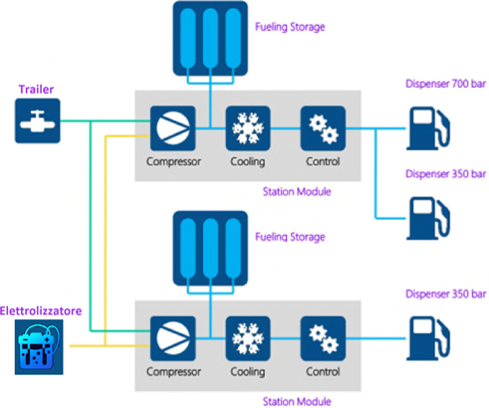
Detailed description of the use case for the public bus transport in Gorizia; Trieste Trasporti, Trieste, Italy
Testbed Partner: APT Gorizia
Detailes Project Description
The hydrogen production plant has a maximum power of 1 MW with a daily production capacity of 400 kg. The hydrogen refueling station is suitable for refueling buses and trucks at 350 bar and light vehicles at 700 bar. The plant will be equipped with two 350 bar refrigerated dispensers for the refueling of HDV (heavy vehicles) and 1 700 bar refrigerated dispenser for LDV. In the event of anomalies in the hydrogen production system, the system will be powered by a wagon-trailer which can operate with an operating pressure of up to 500 bar. To this end, a loading/unloading bay for trailers is provided.
A scheme of the use case for the public bus transport in Gorizia; Trieste Trasporti

Slide 35
Detailed description of the use case for the public bus transport in Gorizia, continued; Trieste Transporti, Trieste, Italy
Below is an initial indication of the main elements:
Electrolysis 1 MW;
Pmax cylinder wagon unloading panel. 500 bars
Compressor H2 Pout max = 500 bar
Compressor H2 Pout max= 1000 bar
Storage H2 Medium Pressure 500 bar
H2 High Pressure storage 900 bar
Cooling System H2 -20°C for refuelling at 350 bar
Cooling System H2 -40°C for refuelling at 700 bar
N.2 H2 dispensers at a pressure of 350 bar for refuelling heavy vehicles/buses
1 dispenser at a pressure of approximately 700 bar for refuelling light vehicles/cars
H2 system control room;
Technical rooms serving the hydrogen refuelling system, including the cooling and electrical supply part;
The system will be managed and maintained locally and remotely by specially trained personnel and refuelling will be carried out by on-site personnel. The plant will be designed, built and operated in accordance with current standards and regulations. Particular attention will be paid to the safety and safe operation of the facility.
The scheme on the previous page shows a first summary indication of the planned configuration, which does not include information on the allocation of the storage benches and the pipe connections.
From the electrolyser or from the trailers, the hydrogen will be sucked in by the compressors located respectively at each „Station module„
and can alternatively be stored inside the appropriate storage benches provided or used directly for refuelling. The system includes two cooling systems, one for each station module, which allow the hydrogen to be brought to the right temperature for refuelling. It is underlined that this configuration could possibly vary in the subsequent design phases also in relation to a more accurate study of the production and supply profiles.
The hydrogen refuelling station is designed in compliance with the Decree of the Ministry of the Interior of 23 October 2018 (Official Gazette of 05 November 2018, n. 257) “Technical fire prevention rule for the design, construction and operation of hydrogen distribution systems for automotive purposes ” and to the Decree of the Ministry of the Interior of 7 July 2023 “Fire prevention technical rule for the identification of methodologies for risk analysis and fire safety measures to be adopted for the design, construction and operation of systems of hydrogen production through electrolysis and related storage systems.”

Slide 36
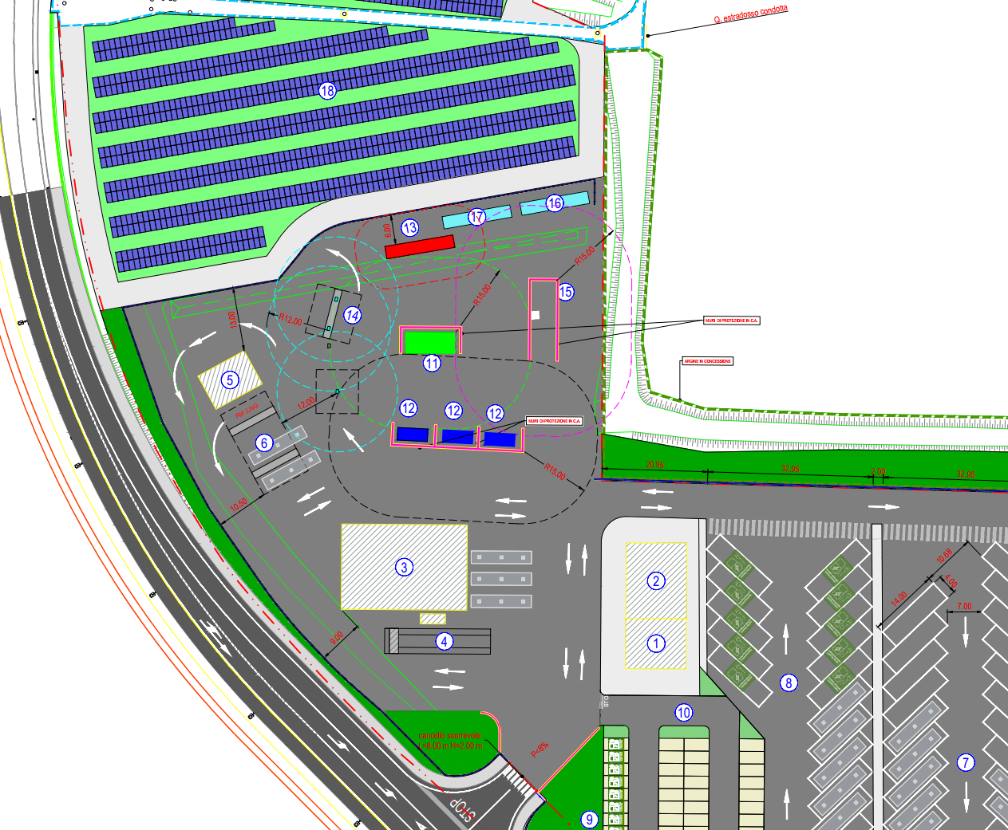
Hydrogen for the public bus transport in Gorizia, Trieste Transporti, Trieste, Italy
Key Metrics
The plant will consist of an electrolysis and discharge panel, two "Station modules" with compression, cooling, and control, two storage benches, and three dispensers for refuelling heavy vehicles at 350 bar (HDV) and 700 bar light vehicles (LDV). Gaseous hydrogen will be supplied to the station on the electrolysis side with an inlet pressure of max 30 bar or on the exchange trailer side with a pressure of up to 500 bar. The hydrogen can be transferred directly to storage units or compressed inside the "Station module" and then transferred to the storage units. The refuelling process follows the international standard SAE J2601-2. For LDV refuelling at 700 bar, the hydrogen is taken from the depot, compressed, and cooled to -40 degrees in the "Station module" and kept cold up to the dispenser. The refuelling protocol complies with SAE J2601-1. The hydrogen cooling system will allow fast refuelling in 3–8 minutes for buses and approximately 4 minutes for cars.
A single electrical panel with a PLC capable of managing the entire production, charging, storage, dispensing, and emergency processes will oversee the hydrogen system. The budget is 10,411,467.00 euro.
Max daily production (indicative): 185 Nm3/h (400 kg/day)
Positioning: outdoor container
Temperature: between -20°C and +40°C
Max altitude: 1000 m above sea level
Noise: <85dB (at 1 m)
Usage range: from 10% to 100%, ramp 10%/sec
Start-up time: <8 min
Nominal cell stack consumption at the beginning of life: 4.7 kWh/Nm3
Nominal consumption of the entire system at the beginning of its life: 5 kWh/Nm3
Water consumption: 280 l/h
General layout of the refuelling station, see details on the next page.

Slide 37
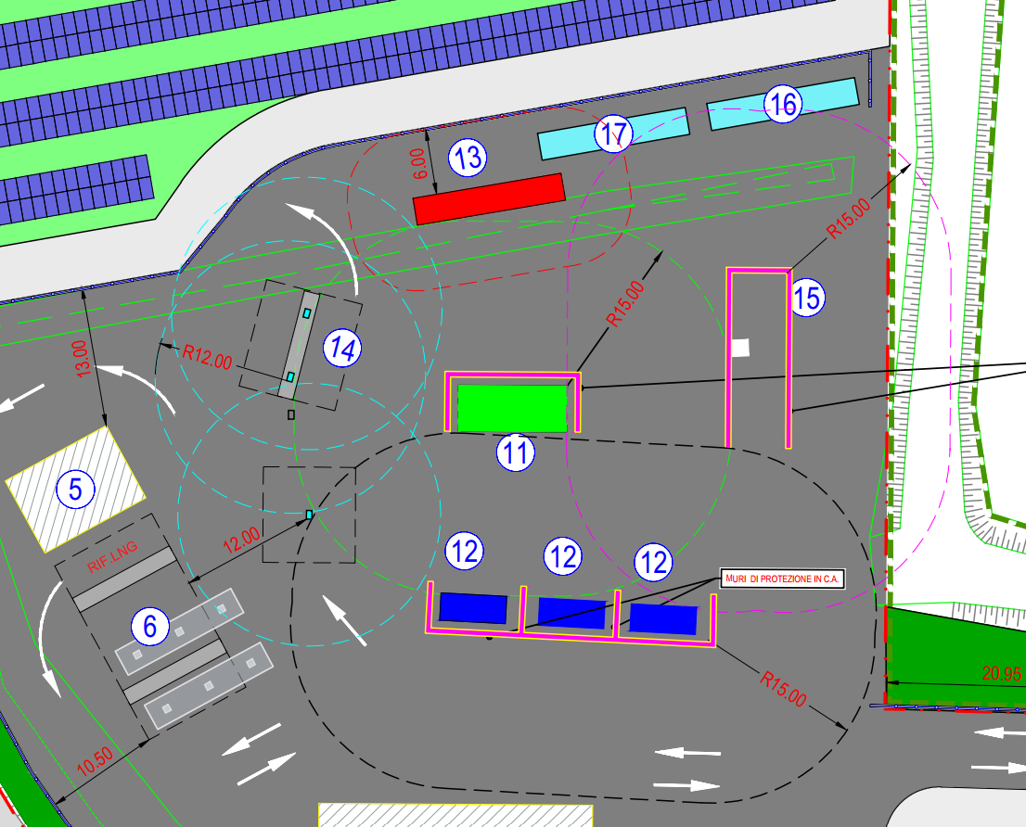
Hydrogen for the public bus transport in Gorizia, Trieste Transporti, Trieste, Italy
Impact and Benefits
The plant will allow the production of green hydrogen (maximum productivity of 400 tones/day) that will also be used to support the transition of part of the TPLFVG fleet from diesel to hydrogen power.
Current Status
The tender for the construction of the plant has been called and awarded. The works will begin by the end of the year and finish by the 30th of June 2026.
Future Plans
The construction works will start at the end of the year.
The general layout of the refuelling station includes the following elements:
MP and AP storage
Compressors
Electrolysis
Filling station
Loading from trailer
Cooling container
Container for electricity supply and auxiliary services

Slide 38
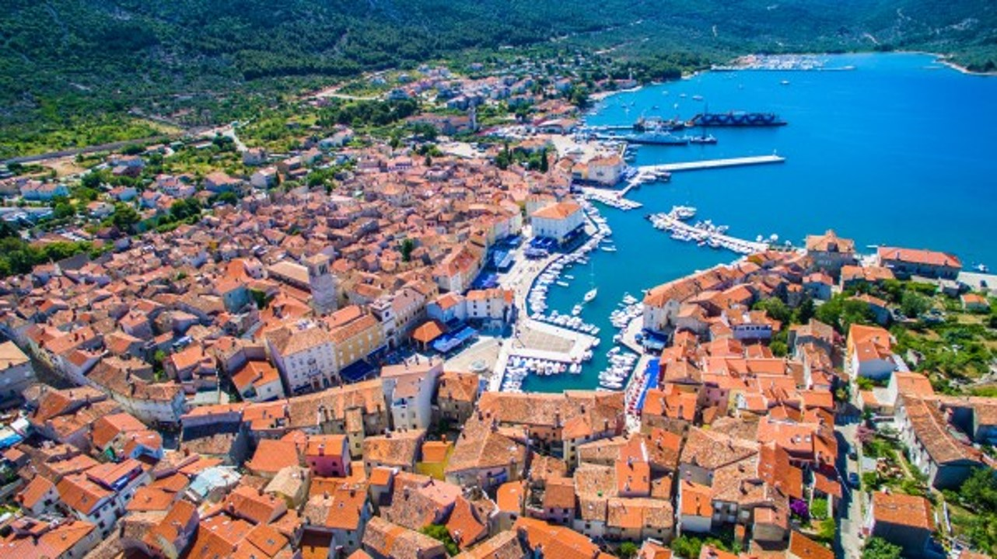
XVI. Hydrogen value chain in the maritime transportation, Island of Cres, Croatia
Testbed Leader: Municipality of Cres
Director (or representative): Ugo Toić, ugo@pplr-otokcres.info
Project Description
The Town of Cres has formally joined the NAHV Consortium in mid-September, as replacement of ACI Club Marina and will undertake the planned activities and expected results envisaged in the project designed for the outgoing partner.
Up until now, the Town of Cres took the decision to join the consortium and, with the ECUBES’s support has been in contact with the consortium lead partner. The Town of Cres has committed to collaborate with ECUBES in establishing a hydrogen technology hub and develop sustainable energy models and transport solutions.
Phase one
The project will start with the conduction of series of feasibility and pre-feasibility studies related to:
Production facility for the production and storage of hydrogen
Hydrogen Storage
Hydrogen filling station
Fuel Cell
Solar Power Plant
Road transport
Hydrogen Powered Electric Foil Catamarans
Up until now, the Town of Cres took the decision to join the consortium and, with the ECUBES’s support has been in contact with the consortium lead partner. The Town of Cres has committed to collaborate with ECUBES in establishing a hydrogen technology hub and develop sustainable energy models and transport solutions.
Town of Cres, Croatia

Slide 39
XVII. Energy storage for distributed power generation based on innovative fuel cell technology of ECUBES, Nova Gorica, Slovenia
Testbed Leader: ECUBES
Ulica Gradnikove brigade 49, 5000 Nova Gorica, Slovenia
Director (or representative): Aleksander Gerbec
Contact: Mojca Golež (mojca.golez@ecubes.eu)
Project Description
This project involves a highly deployable, containerized energy storage and power generation solution with 1MWh capacity, using an innovative hydrogen carrier. It will be implemented in remote areas to support hydrogen-powered vehicles or EV charging. Developed by Ecubes from TRL2 to TRL6, it has already been tested at the Salonit cement factory. Over the next two years, it will reach TRL8 and undergo extensive testing.
The solution enables renewable hydrogen production and its use in a closed-loop system, addressing intermittent renewable energy issues by
integrating transport, stationary power, or seasonal storage. A fuel cell, combined with innovative hydrogen storage, provides on-demand energy.
The project also supports hydrogen as fuel for refuelling stations or general energy use, with a goal to reduce CO2 emissions. Distributed across five locations in three countries, it’s expected to save 5,000 tons of CO2 annually, with a feasibility study for large-scale investment.
Key Metrics
The testbed project uses fuel cells (FC) for distributed power generation, converting hydrogen into electricity with high efficiency, durability, and silent operation. It stores energy as liquid hydrogen, a compact and efficient carrier ideal for long-term storage and transportation. In this project, it powers EV charging stations, demonstrating hydrogen’s potential in clean mobility.
The system operates in a closed-loop process, minimizing waste and optimizing resource use. Designed for flexibility, the containerized energy
storage system can be deployed in remote or off-grid locations. It supports clean energy by converting hydrogen into electricity, enabling distributed power generation near the point of use, which enhances efficiency and reduces transmission losses.
A key feature is carbon credit tracking, which quantifies and monetizes greenhouse gas reductions, serving as a model for regions looking to adopt hydrogen-based energy systems. The project targets 1 MWh of energy storage with liquid hydrogen for use in EV charging stations, with a total budget of €5.6517 million, covering hydrogen production, storage, and equipment.
Impact and Benefits
The project will promote the adoption of hydrogen-based technologies among businesses, SMEs, and research institutions. By demonstrating the viability of hydrogen production, fuel cells, and energy storage, participants will be able to integrate these technologies into their operations, contributing to decarbonization efforts, particularly in smart communities.

Slide 40
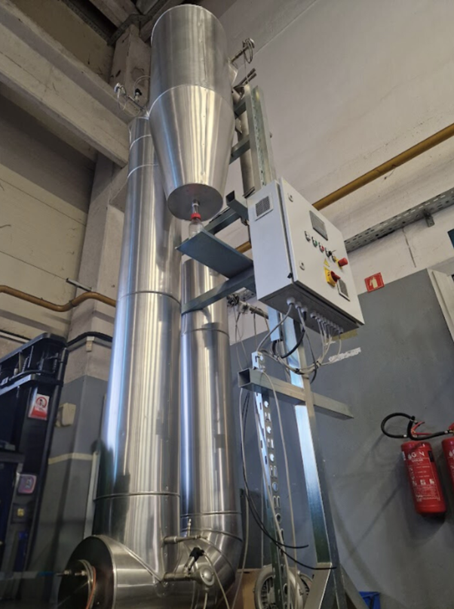
Energy storage for distributed power generation based on innovative fuel cell technology of ECUBES, Nova Gorica, Slovenia
Participants in energy production, storage, and distribution will benefit from the flexible, containerized system, which can be deployed in various settings, from rural areas to urban centers. The project will also provide real-time data to help participants optimize energy use and better understand hydrogen's potential, guiding future decisions and investments.
Current Status
The testbed pilot is assembled from various components, including a reactor, regenerator, washer, condenser, compressor, fuel cells, and a hydrogen liquid carrier. Shortcomings were identified in the reactor and washer, both at TRL6. Significant progress has been made with the regenerator, advancing it to TRL7 by implementing new chemical engineering for material recovery, conducting simulations, and preparing mechanical and electrical designs using advanced components.
Eco-design principles were incorporated to enhance sustainability. The system has been fully assembled and programmed for automation and safety, with a cold start underway.
The ORYX GREEN ADRIATIC BLUE initiative, launched at the World Economic Forum in January 2023, promotes sustainable development and green energy in the Adriatic region, focusing on hydrogen and clean energy technologies.
Future Plans
The next steps involve refining key components of the testbed, focusing on chemical, mechanical, and electrical optimizations to improve automation and efficiency. We will start with a "cold start" of the Regenerator TRL7 to test mechanical and electrical functions. After successful insulation, full-scale testing will be conducted to fine-tune system performance, optimize energy use, and ensure ECO efficiency.
Once the components are ready, we will fully integrate the testbed with automation to minimize manual intervention and enhance safety. All safety protocols, especially for chemical processes and heat management, will be implemented. We are also collaborating with stakeholders on solutions for long-distance hydrogen transportation, including potential imports to the North Adriatic region.
Regenerator TRL7

Slide 41
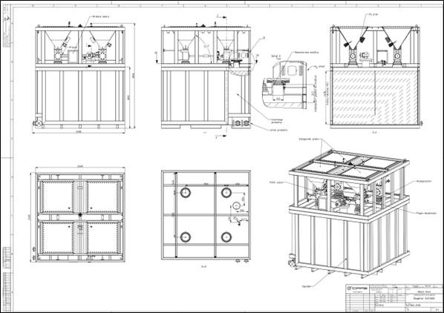
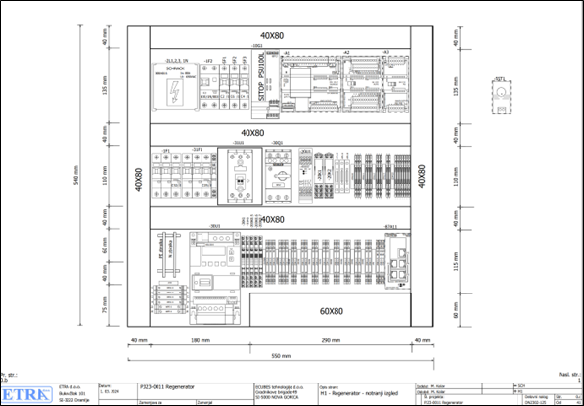
Energy storage for distributed power generation based on innovative fuel cell technology of ECUBES, Nova Gorica, Slovenia
Plans for Reactor
Excerpt from electrical plans Regenerator TRL7

Slide 42
www.nahv.eu

