Slide 1
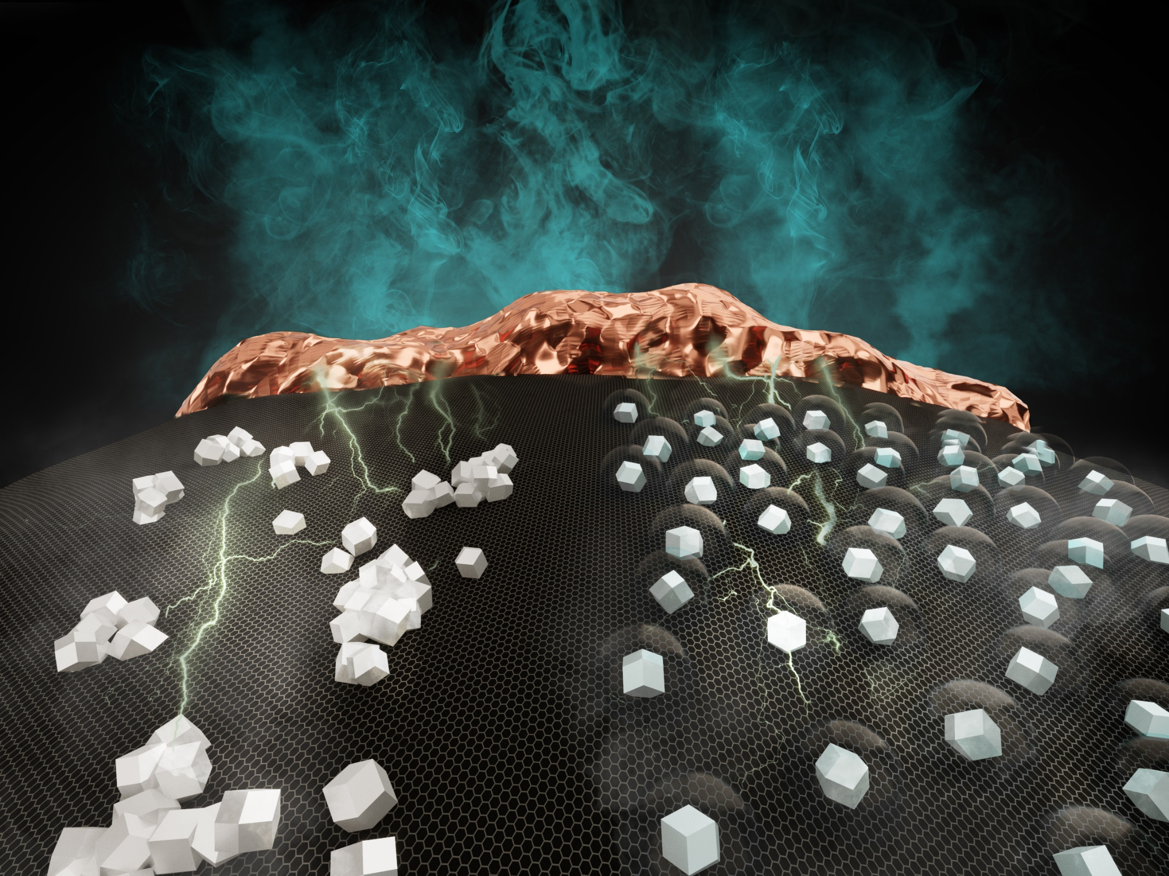
Black Powder at the Heart of the Hydrogen Economy

Slide 2
ReCatalyst‘s
future outlook
Mission
Vision
By providing customizable next generation platinum alloy catalyst solutions, we are enabling our customers massive scalability, high power hydrogen Fuel Cells with an optimized usage of platinum group metals.
Creating value through
REvolutionary CATALYST
materials to enable
decarbonisation of the energy and transport sectors.

Slide 3
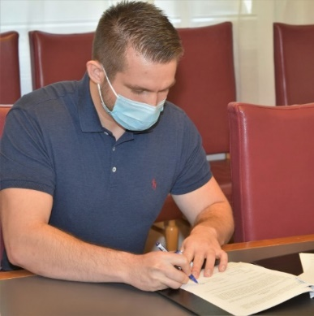
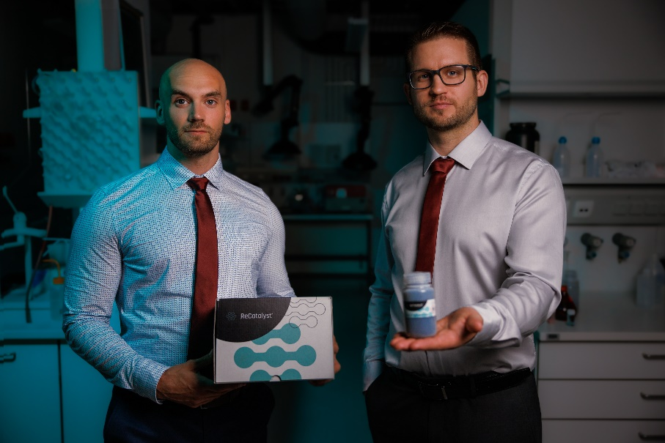
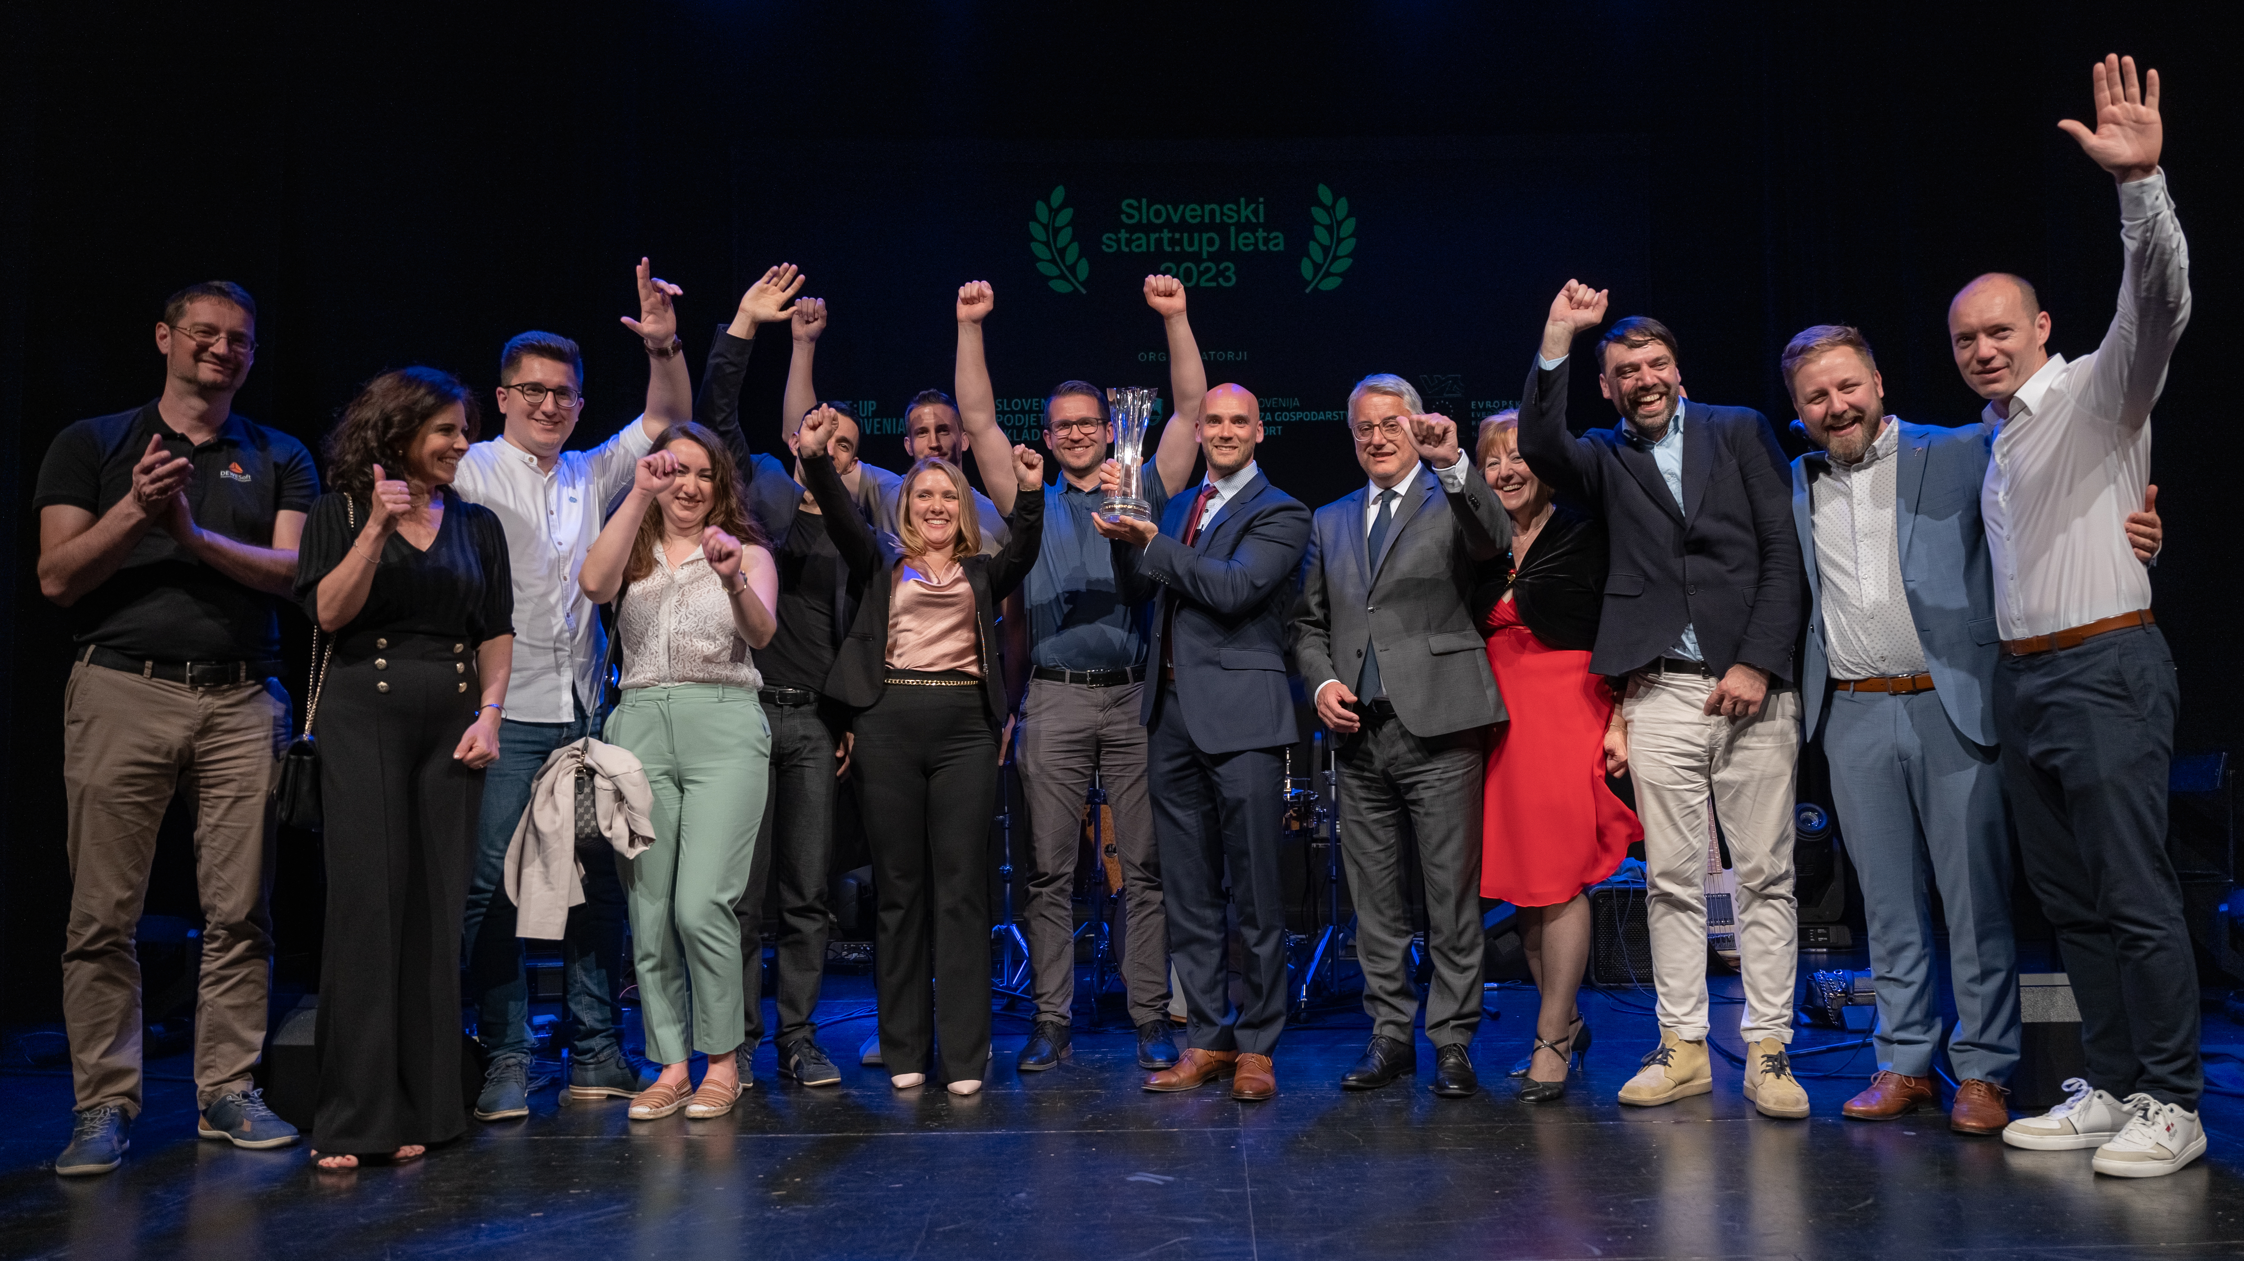
Timeline
‘MVP’ catalyst & reactor design
of ReCatalyst
>20 industrial clients
from 5 out of G7 economies
Exclusive licensing agreement
x
Slovenian
Start-up of the Year
Spin-out incorporation
‘MVP’ catalyst validated in the real Fuel Cell environment
x
Reached first customers
Q4 2020
2021
2022
2023 & 2024
1st place
EIT Accelerator I.
EIT Accelerator II.
EIT Accelerator III.
PoC ‘StableCat’
Winners of the 2021 BASF innovation hub
EIC Transition
x
x
x
Falling Walls Venture winners
Top 10 hydrogen energy tech challengers
Seed round closed
Shortlisted for Hydrogen Industry Roundtable & Sustainability22

Slide 4
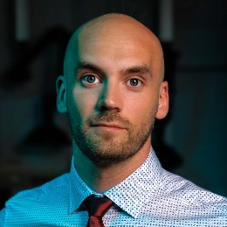
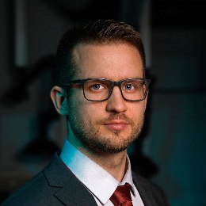
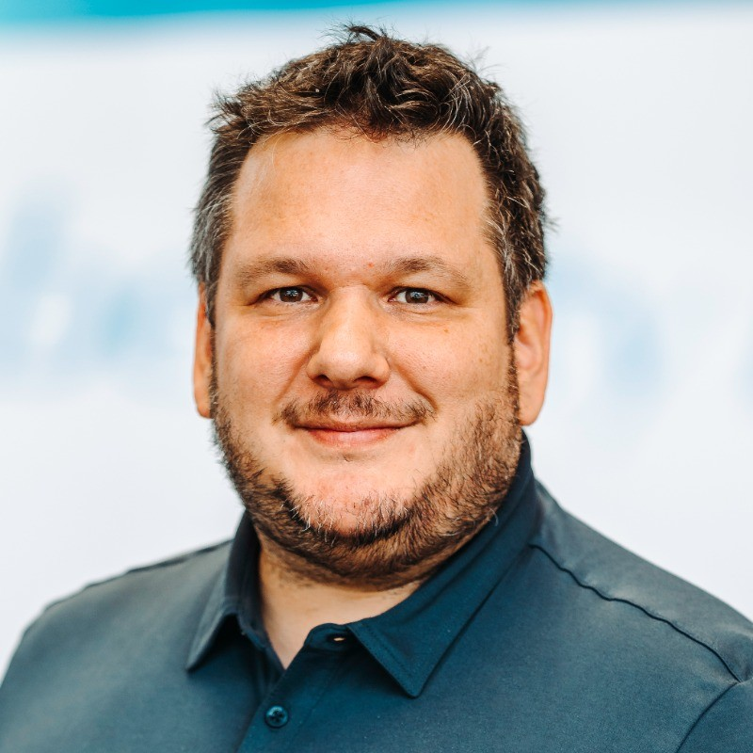
The Founders and the Team
with over 5 years of track record
Seed investors
Tomaž Bizjak, MPhil
Co-founder, CEO
Deep-tech translational set of skills from the University of Cambridge, shortlisted finalist for Cambridge Entrepreneur of the Year, and GapSummit Leaders of Tomorrow in 2016. Led the tech transfer office, achieved numerous Start-up awards and prestigious commercialisation grants.
Matija Gatalo, PhD
Co-founder, CTO
Main inventor of ReCatalyst’s technology that originated from his PhD, 10+ years of experience in development of fuel cell catalysts, main inventor of 2 patent families, numerous PhD awards, in total over 15 awards & recognitions
Tine Tomažič, CTO of Pipistrel
(business angel)
16 personnel
11 full-time employees across business development, engineering & production, and product development
5 seconded professionals in financing, business operations, and legal
Advisors
With outsourced partners such as Haseltine Lake Kempner IP firm
Jerneja Lončar, MBA

Slide 5
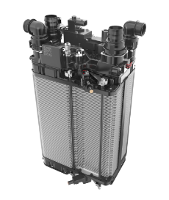
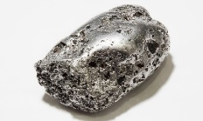
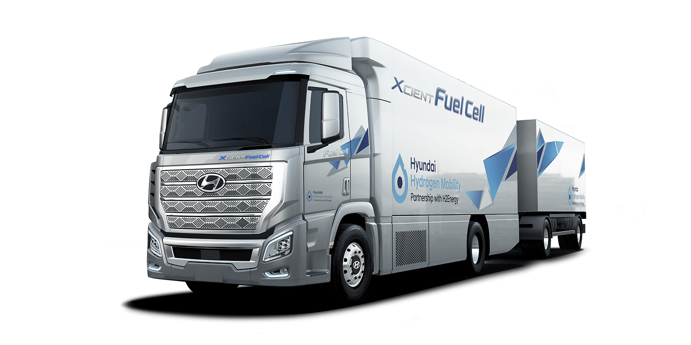
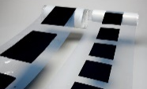
Over 20 industrial clients from 5 out of G7 economies
we work and collaborate across the whole Fuel Cell value-chain
Raw Materials (platinum, cobalt, carbon support)
Components’ production
We fit here
Catalyst coated membrane (CCM)/MEA production
Fuel Cell stack & system manufacturing
Power-train & end-product manufacturers
1
2
3
4
5

Slide 6
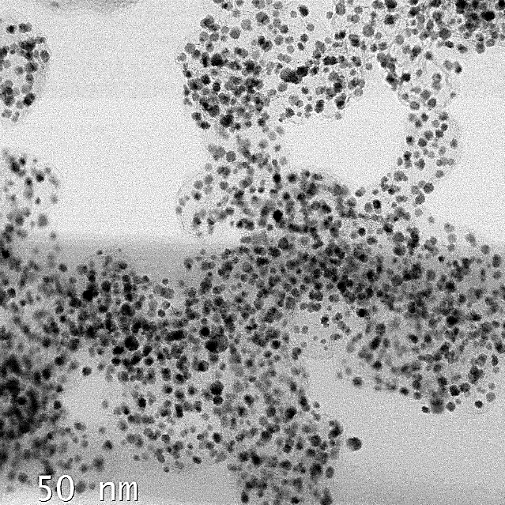
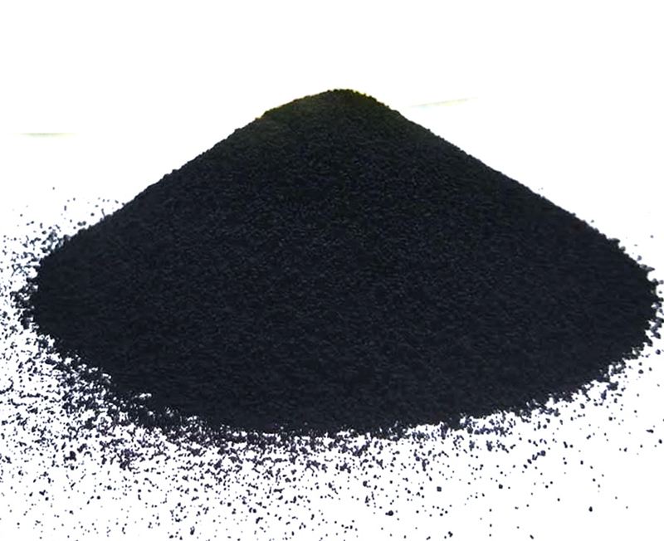
Our catalyst production nano-tech platform
is being scaled-up with the fuel cell product ready to reach the market
50 nm
Superior distribution of platinum-alloy nanoparticles
Ordered structure of platinum & cobalt, on a carbon surface

Slide 7
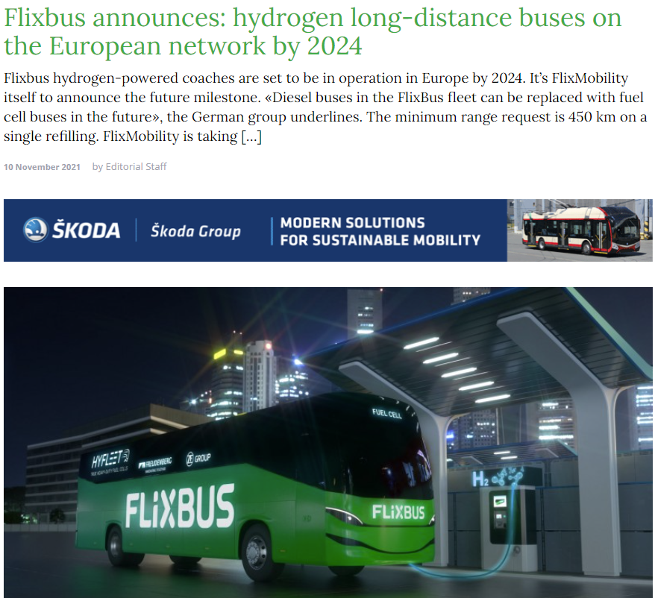
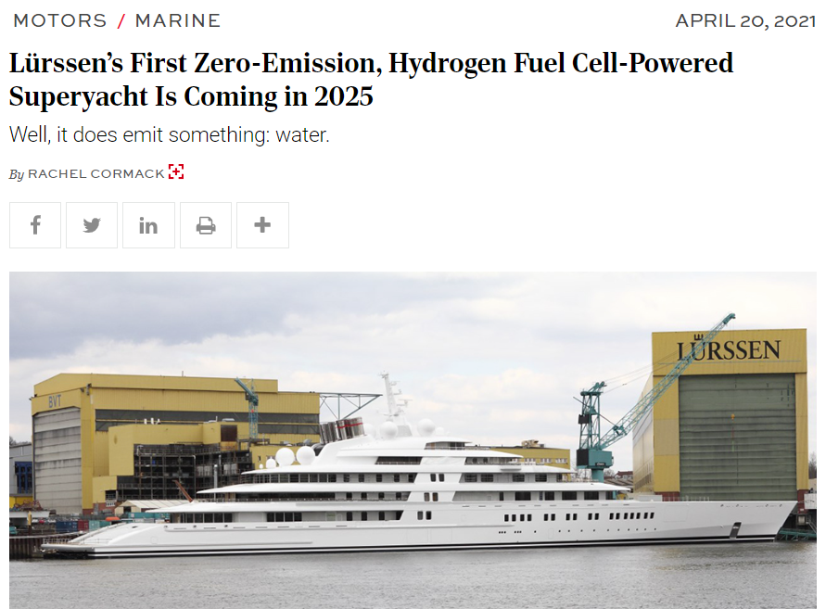
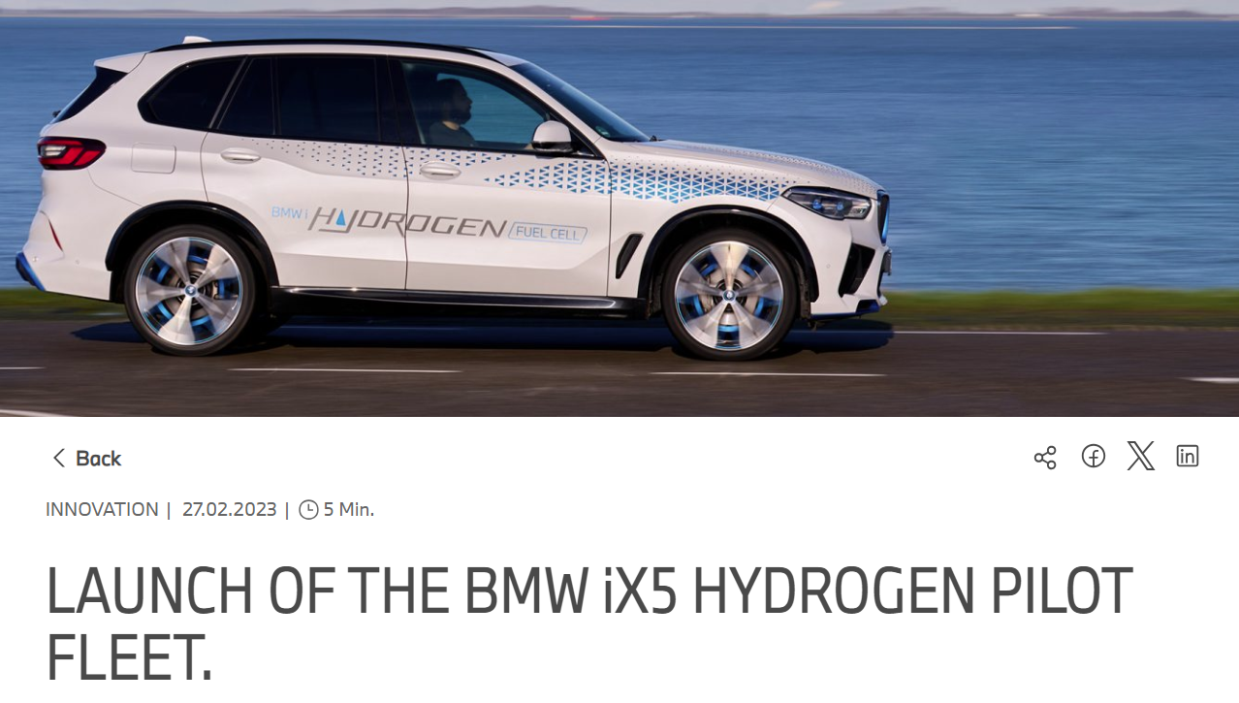
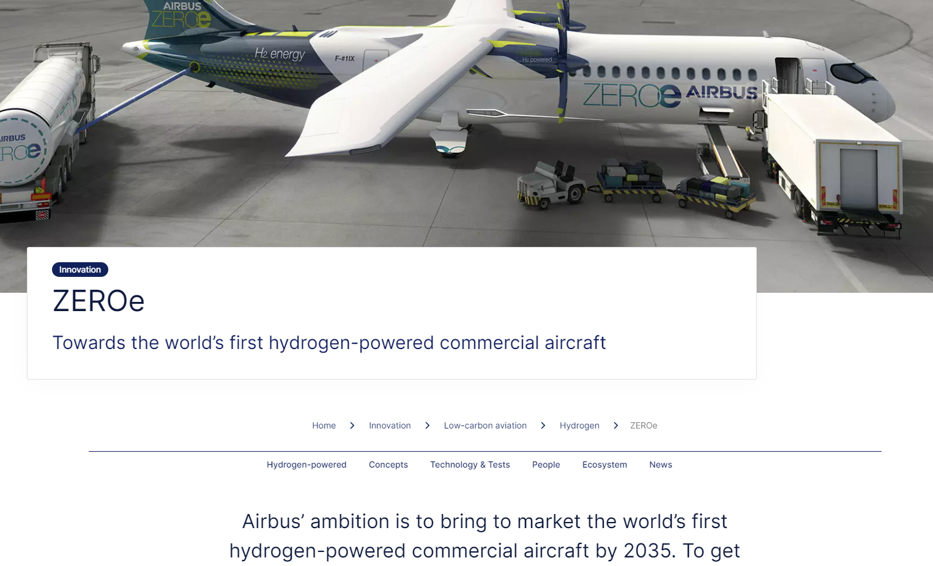
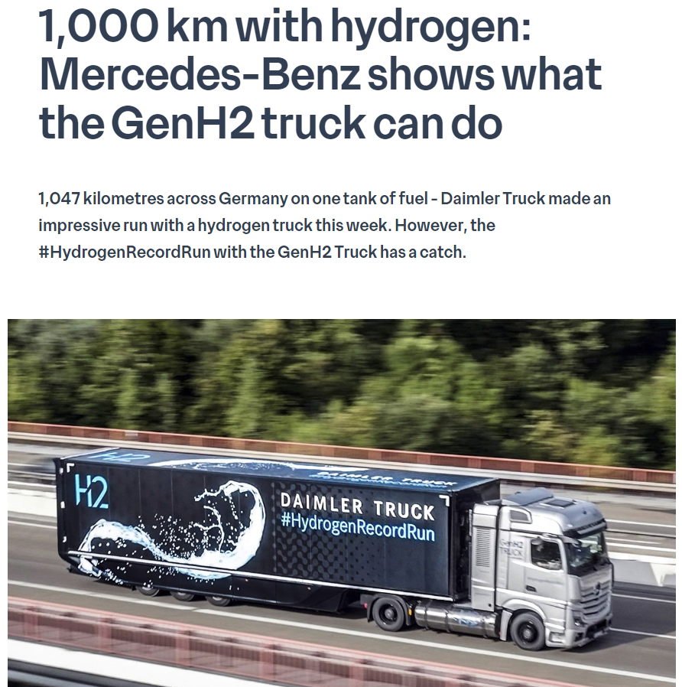
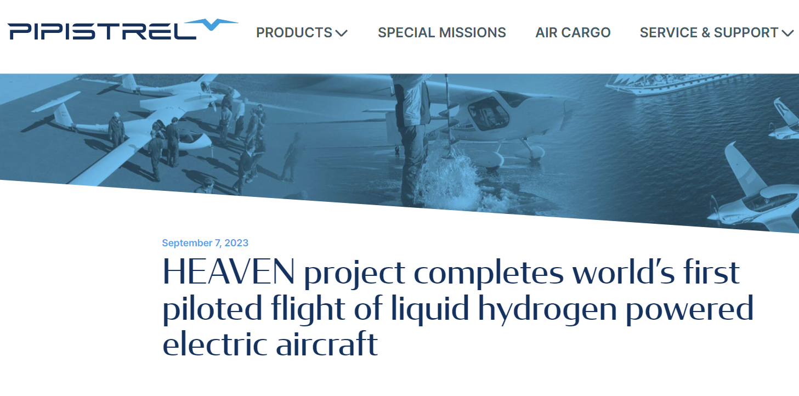
From pilot projects to commercial applications
the market is developing and growing

Slide 8
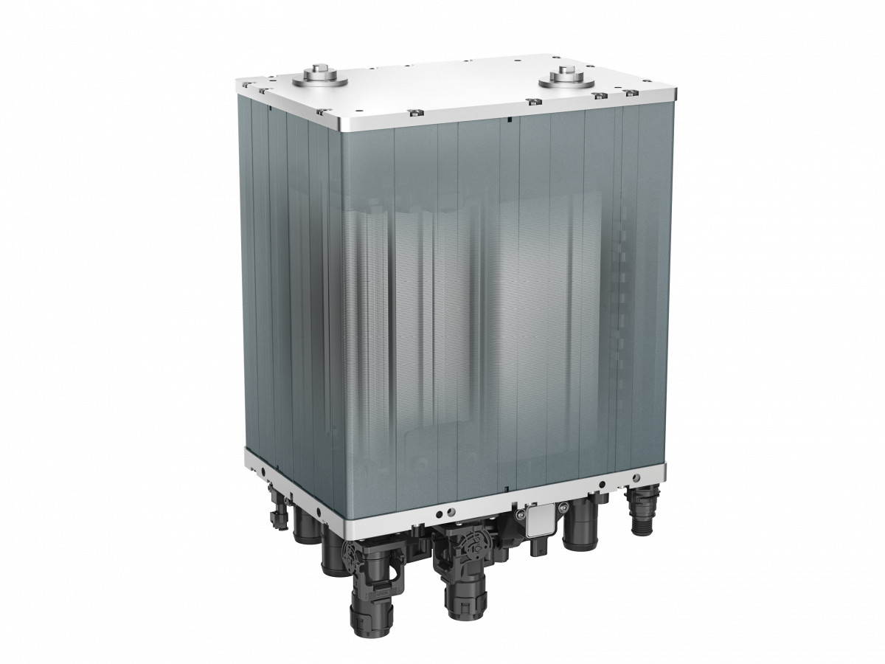
The heart of each fuel cell is a Membrane Electrode Assembly (MEA)
+
Membrane electrode assembly (MEA)
(Subcontractor)
Fuel cell stack
50 nm
Membrane
Catalyst
catalyst
Ionomer
ionomer

Slide 9
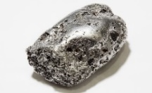
The current state-of-the-art MEAs have two critical problems
Expensive and scarce platinum in the catalyst
Fluoropolymers in membrane and ionomer (PFSA) as a huge environmental burden
Bio-accumulating (“Forever chemical”)
Fuel cell electric vehicle
~10x!
Platinum per vehicle
Toxic and causing serious health conditions
Difficult and expensive recycling
Internal combustion engine
Demand
?
Platinum
Supply

Slide 10
ENABLER will help bring technological breakthrough from TRL 3-4 to TRL 6, advancing the time-to-market for novel fuel cells
+
WP1 PROJECT MANAGEMENT AND COORDINATION
(Subcontractor)
WP2 CATALYST FINETUNING AND REACTOR PROTOTYPING
WP6 KNOWLEDGE MANAGEMENT, DISSEMINATION AND EXPLOITATION
Budget
€ 2,5 Mio
+
EKPO (WP 4)
€ 0,28 Mio own funding
WP3 CCM & MEA FABRICATION AND SCALE-UP
WP4 SINGLE-CELL AND SHORT STACK VALIDATION
Project mgmt (WP 1)
WP5 DEVELOPMENT OF MARKET READINESS
Tech development (WP 2 &3)
Market readiness development (WP 5 & 6)
DEMONSTRATION OF A NEXT-GENERATION PFSA-FREE FUEL CELL SHORT-STACK (TRL 6)
PFSA-FREE
MEAs
KPIs
REDUCED PLATINUM LOADING
(0.3 g/kW)
OPERATING TEMPERATURE
(105 ºC)
FUEL CELL STACK COST
(<75 eur/kW)
FUEL CELL STACK DURABILITY
(20 000h)
HORIZON-EIC-2022-TRANSITIONCHALLENGES-02

Slide 11
WE ARE HIRING!
Senior Process Engineer position
SENIOR PROCESS ENGINEER
BSc or higher in Chemical engineering or similar fields
3 or more years of work experience in industry
Prior work experience in chemical, pharma, or similar industries in ideally senior positions
Experience with the development of chemical processes, reactors, and other processing equipment
Familiarity with CFD modelling is an advantage
SCAN ME!
https://recatalyst.si/careers

Slide 12
WE ARE HIRING!
Senior Process Engineer position
SENIOR PROCESS ENGINEER
BSc or higher in Chemical engineering or similar fields
3 or more years of work experience in industry
Prior work experience in chemical, pharma, or similar industries in ideally senior positions
Experience with the development of chemical processes, reactors, and other processing equipment
Familiarity with CFD modelling is an advantage
SCAN ME!
https://recatalyst.si/careers

Slide 13
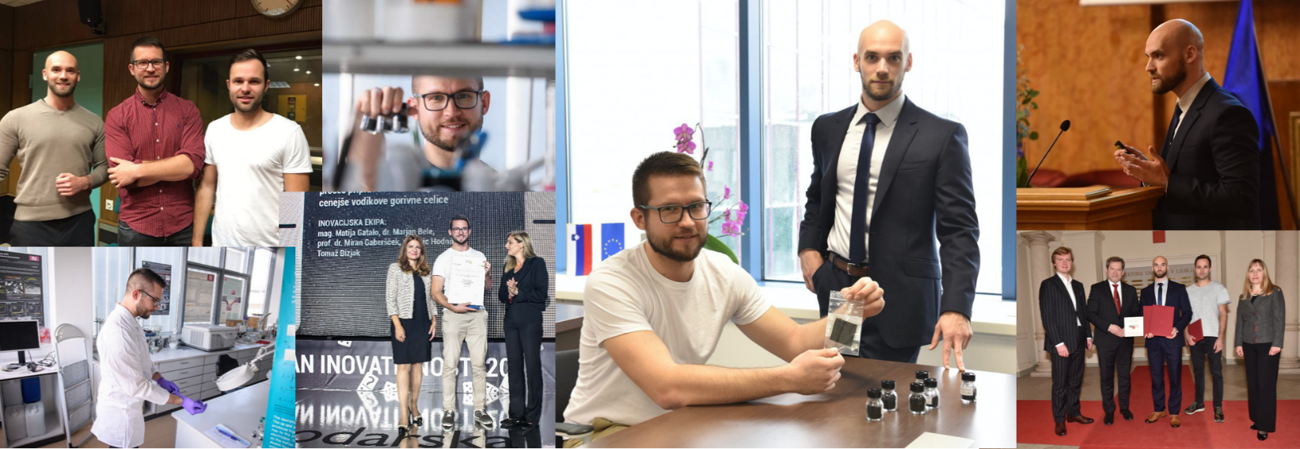
FUNDING
Project
StableCat
AWARDS & RECOGNITIONS
recatalyst.si

