Slide 1
Razogljičenje z vodikovimi tehnologijami, zajemom ogljika in rabo biomase
Ilja Gasan Osojnik Črnivec, Dana Marinič, Brigita Hočevar,
Tina Ročnik Kozmelj, Edita Jasiukaityte Grojzdek, Blaž Likozar

Slide 2
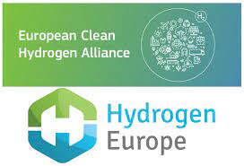

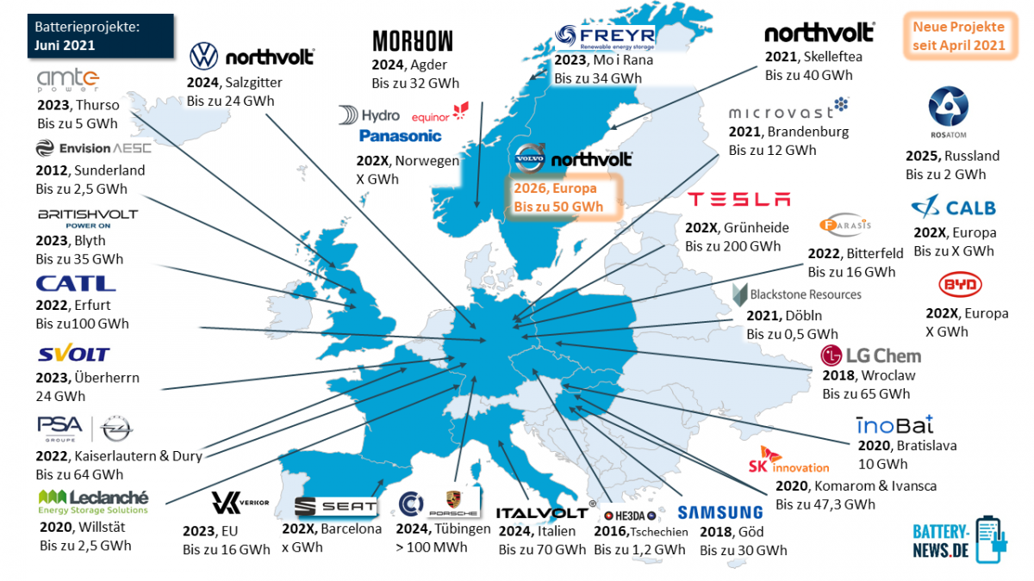
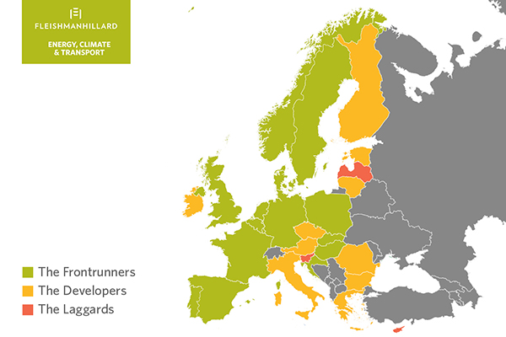
Razvoj brezogljičnih tehnologij v Evropi

Slide 3
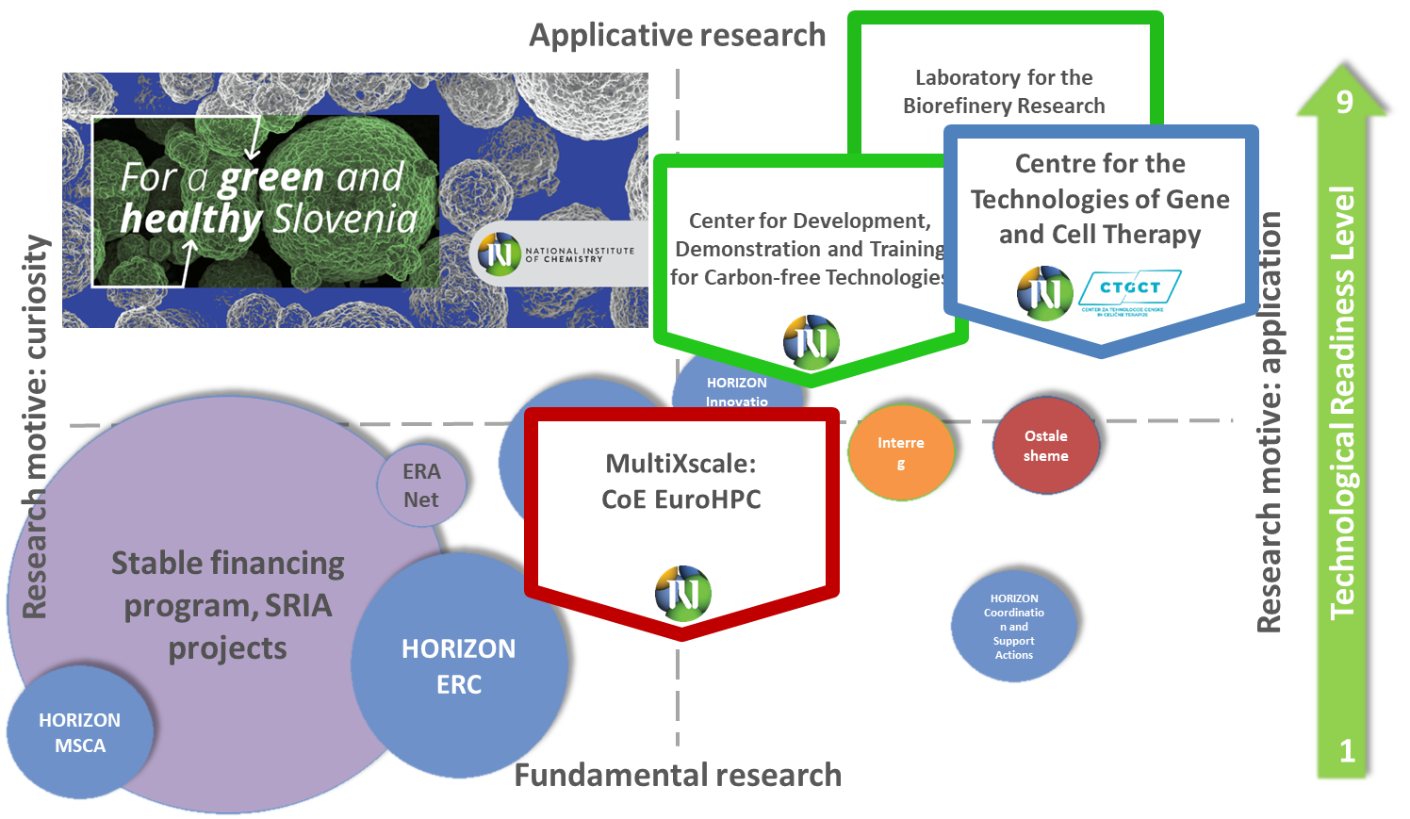

Slide 4
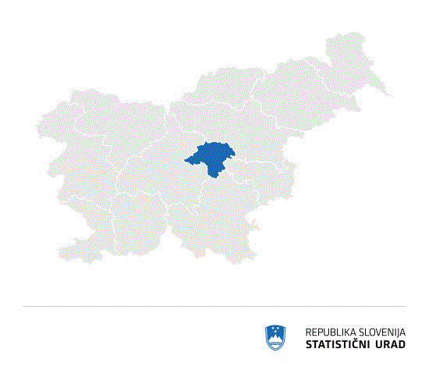
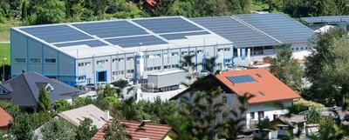
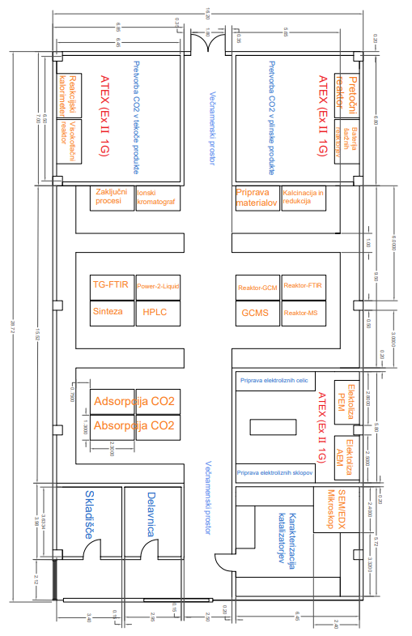
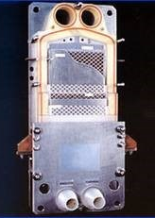
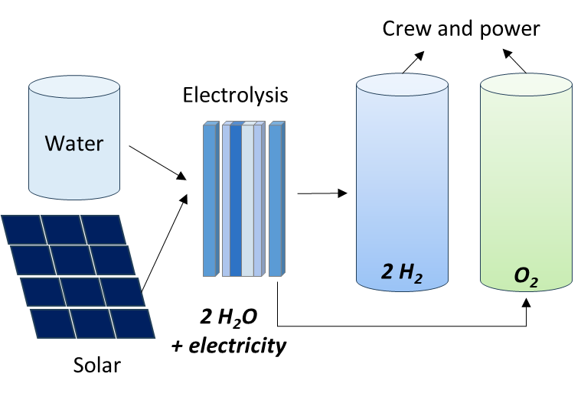
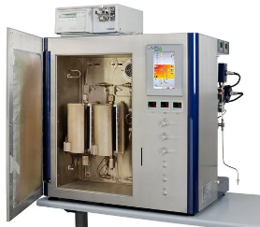
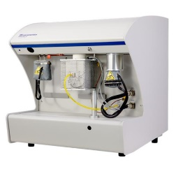
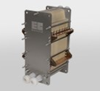
Laboratory for the demonstration of H₂ and CO₂ technologies
Zasavje region
Center DUBT
https://www.ki.si/en/news/zelena-luc-za-center-dubt/
Chemical engineering for alternative energy, fine chemical production, decarbonisation
and energy intensive industries, at industrially relevant operating conditions.
MATERIALS
CATALYSIS
ELECTROLYSIS
including support to cross-cutting biological processes and waste utilisation challenges
catalysts, sorbents, electrodes, membranes
gas to gas, gas to liquid standard, HT, HP
AEM, PEM, water, hybrid
highly customizable pilot hall with several dedicated ATEX zones.
Contact:
Gasan Osojnik, gasan.osojnik@ki.si Centre for development, demonstration and training for carbon-free technologies, National Institute of Chemistry

Slide 5

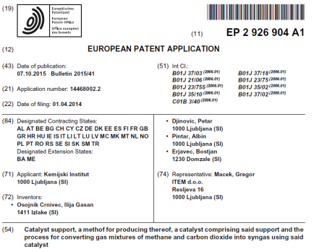
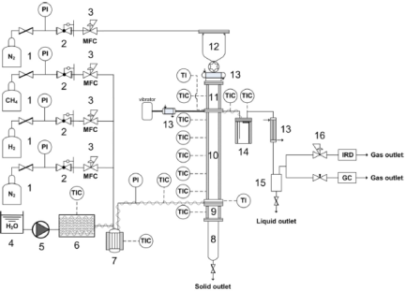

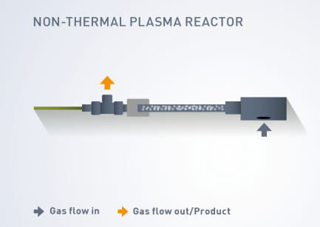
Ključni elementi, ki potrebujejo demonstracijo
H₂ TEHNOLOGIJA
Netradicionalni Metan pretvorjen v VODIK
• Metan je bolj škodljiv kot CO₂
• Letno 10¹¹ m³ metana se izgubi– 30% EU porabe
• To so lokalizirani, točkovni izpusti
(Forbes)

Slide 6
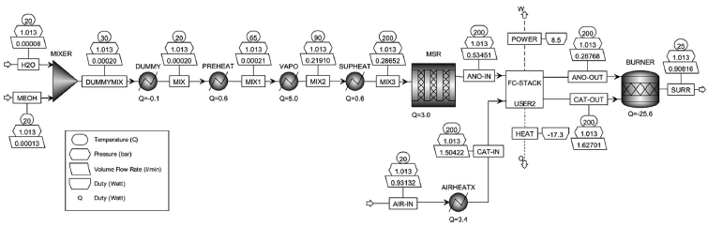

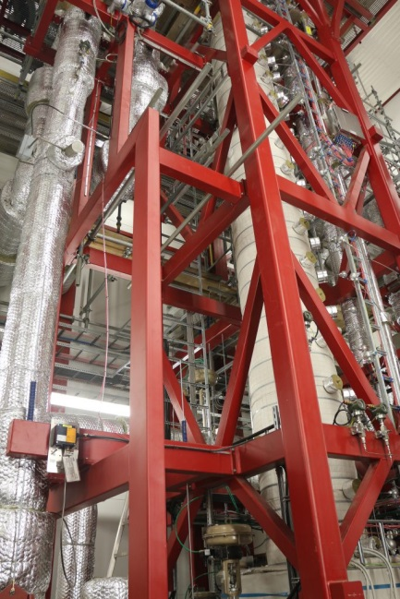
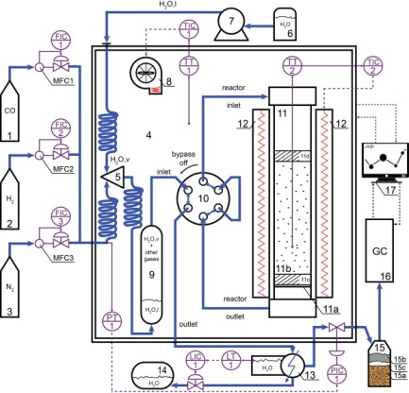
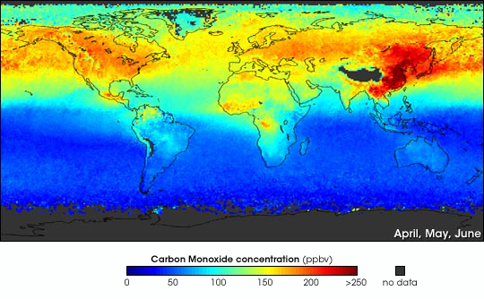
Ključni elementi, ki potrebujejo demonstracijo
H₂ TEHNOLOGIJA
CO/Metanol/Etanol pretvorba v VODIK
• • veliko energije CO + H₂O ⇌ CO₂ + H₂
• Metanol -> H₂ v tekočem stanju
• Etanol se proizvaja iz biomase
(NASA)

Slide 7

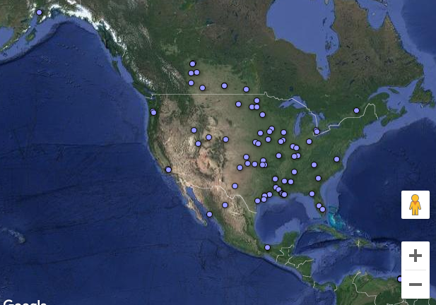
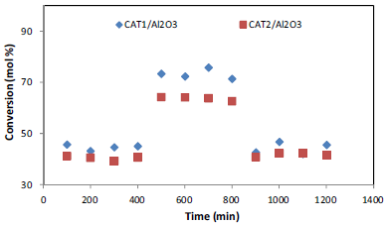
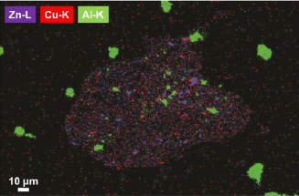
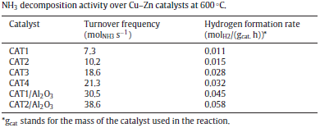
Ključni elementi, ki potrebujejo demonstracijo
H₂ TEHNOLOGIJA
Amoniak za shranjevanje/pretvorbo v vodik
• NH₃ je dobro topen v vodi = dobre lastnosti za sshranjevanje
• sestavina v gnojilih
• reagira z ureo, razogljičenje s CCU: 2NH₃ + CO₂ ⇌ (NH₂)₂CO + H₂O
• NH₃ povzroča obsežno porabo energije (3%)
• H₂ se sprošča pri zelo blagih pogojih
(ammoniaindustry.com)

Slide 8
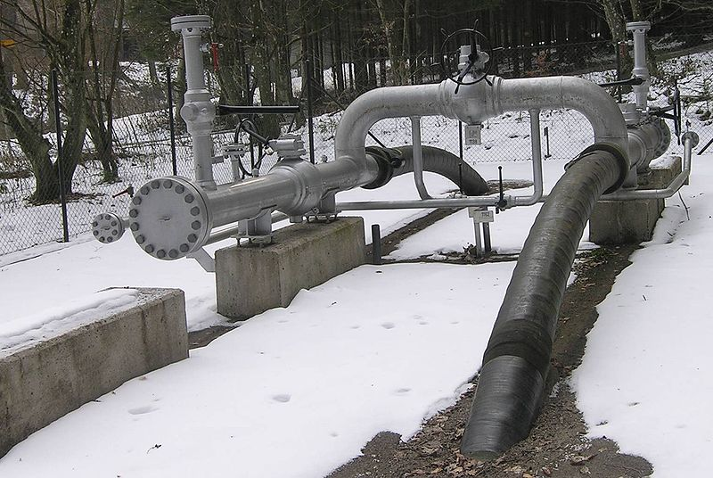
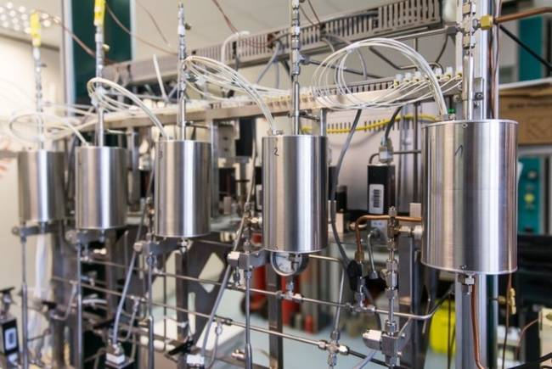


Ključni elementi, ki potrebujejo demonstracijo
CO₂ TEHNOLOGIJA
Open Innovation Test Beds pristop
• Brez bazičnih raziskav (TRL 1−4)
• TRL (5−8) piloting/demonstration
• Key Enabling Technologies (KET): nanotechnology, advanced materials & advanced manufacturing technologies
• Public–Private Partnership (PPP) open innovation approach
• Addressing R&D Risk: lagging behind EU
Power-to-gas (CO₂-> CH₄) Power-to-liquid (CO₂-> methanol...) Power-to-polymers (from fermentation CO₂ to commercial resin)
(A. Meskauskas) (NIC)

Slide 9
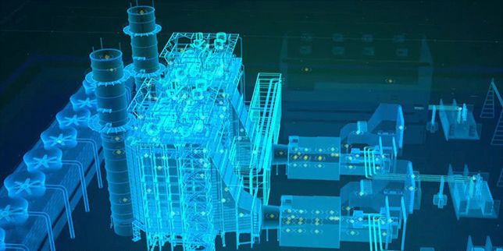
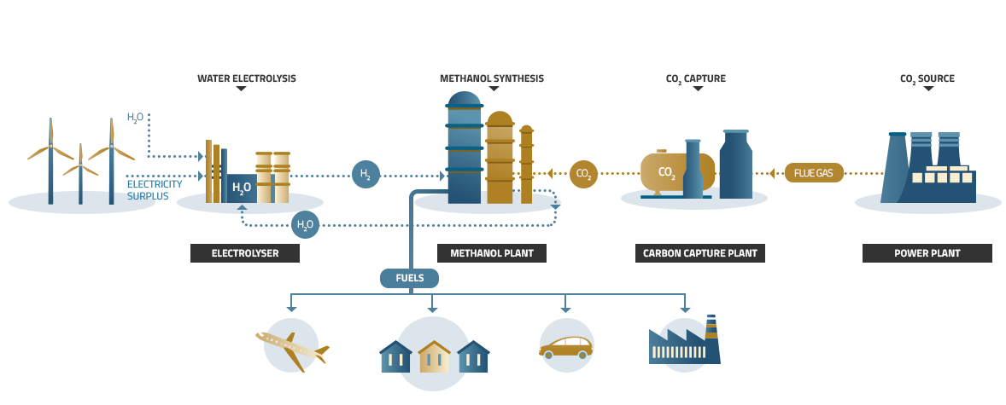
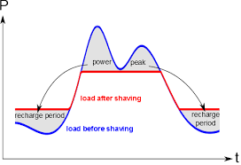
Ključni elementi, ki potrebujejo demonstracijo
CO₂ TEHNOLOGIJA
No One size fits all
• Tradicionalno delovanje enote je stabilno
• Delovanje nastajajoče enote je manjše, dinamično, prilagodljivo in medpomnilniško
• Tradicionalni surovinski viri so stalni
• Nastajajoči surovinski viri so različni, razredčeni in vsebujejo nečistoče
• Potreba po konfiguraciji
(engineering.com)
(sandia.gov)
Buffer!

Slide 10
Direct Air Capture (DAC)
Overview
Direct Air Capture (DAC) is a technology designed to remove carbon dioxide (CO2) directly from the ambient air.
It is determined as physical or chemical separation and concentration of CO2 from ambient air producing high-purity CO2 steam (≥95%)
Currently available DAC systems are based on the passage of air through the air contactor, where the chemicals, membranes, or refrigeration capture and release CO2.
The most elaborated and studied techniques use the binding of CO2 to liquid solvents (strong basic hydroxide solution) or solid sorbents (amine-functionalized highly porous support).
Location
Challenges
Unlike traditional capture methods, DAC can target dispersed sources.
DAC technology is still evolving and requires further development.
Possible applications
Air pollution
Captured CO2 can be stored, utilized, or converted.
DAC holds significant promise for mitigating climate change and preserving the future

Slide 11



Why is DAC commercialization limited?
01
Technically challenging
Problem
Sorbent regeneration, scale-up, cost, energy intensive and environmental impacts (energy consumption, land use, potential emissions,..).
02
Energy-intensive
Problem
The energy requirement highly depends on the enthalpy of the solvent/sorbents-CO2 binding reaction. Strong CO2 binging to adsorbent is desired in terms of selectivity, however, it increases regeneration cost because of the high energy required for the CO2-adsorbent interaction fracture.
03
Problem
One of the most expensive CDR routes
It is consuming up to three times more energy than other CDR pathways.
04
Low CO2 concentration in the atmosphere
Reason
which is 0.04% compared to 5% in natural gas-fired flue gas and 12% in coal-fired flue gas.

Slide 12
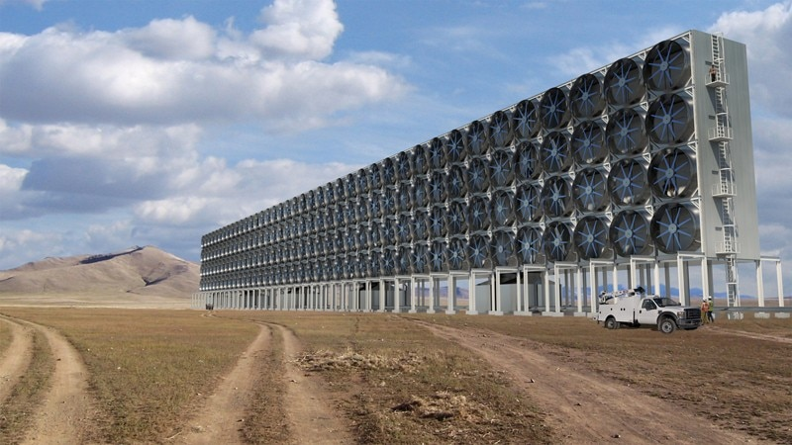
Multiscale modelling
Multiscale modelling emerged as a promising tool for rapid screening from a vast scientific collection of prospective selected candidates.
It was also proven to be a convenient alternative to laboratory work since it gives insight into a complex system otherwise difficult to explore experimentally.
Considerably reduces the time and cost of upgrading or developing new carbon capture technologies.

Slide 13
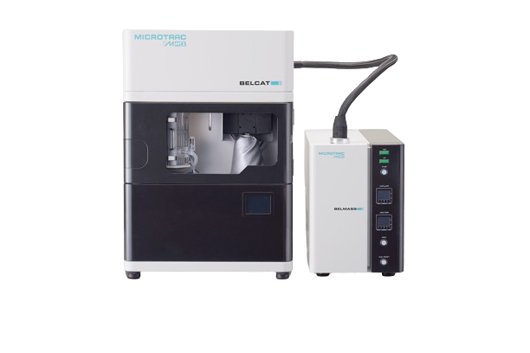
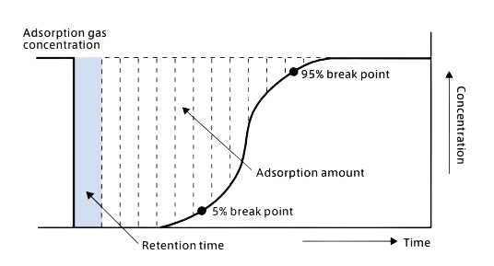
Breakthrough curve measurement
Adsorption breakthrough curve measurement
Catalyst analyzer BELCAT II:
Pulse, TPD, TPR, BET, Breakthrough curve, various catalytic reactions

Slide 14






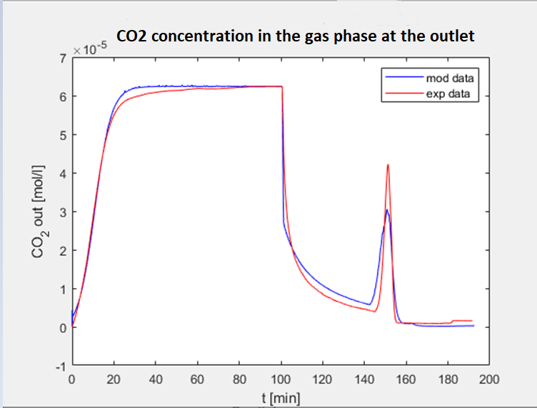
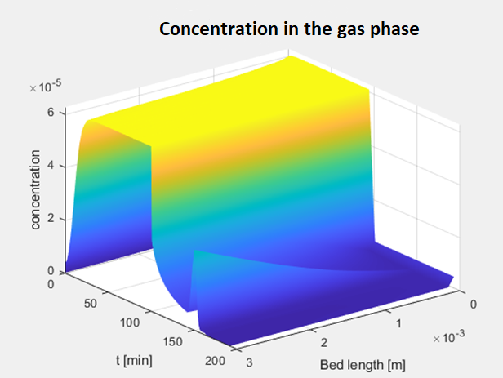
Fitting exp data
LDF
Dynamic models
Energy requirement
Production rate
Cost
q*
equilibrium ads capacity
∂q/∂t
Rate of adsorption
Mass balance
Toth model
Pseudo-first order model
gas phase balance
solid phase balance
Experiments
energy balance
Model
TD+kinetics:
thermodynamics descripted by isotherms
mass and energy balances of gas and solid
pressure drop
Theoretical simulation results can be directly compared to macroscopic experimental data which validates the accuracy of modelling methods.

Slide 15
Laboratory for the biorefinery research in Velenje
TecHUB i4.0
Possibility to follow ambitious bio-economy trends, the integration of technologies,
demonstration and further production scale-up of potential end products.
Contact: Edita Jasiukaitytė-Grojzdek, edita.jasiukaityte@ki.si Department of Catalysis and Chemical Reaction Engineering, National Institute of Chemistry

Slide 16
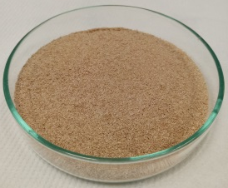
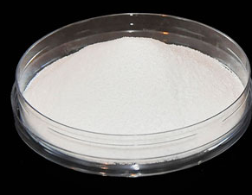
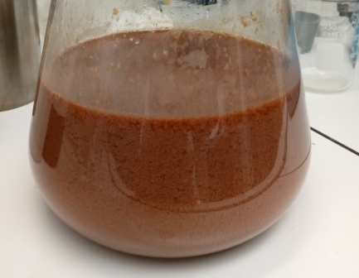
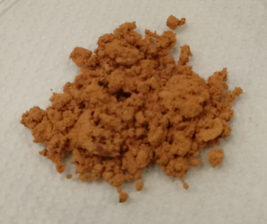
Pulping: organosolv Lignin
LIGNIN-first approach
Lignocellulosic biomass
Advantages
High quality lignin that is suitable for the thermocatalytic conversion into the value-added chemicals such as aromatics
Most of the β-O-4 linkages in lignin are preserved
CELLULOSE
Disadvantages
EtOH/H₂O, H₂SO₄
Less abundant material in market – production is increasing
Organosolv pulping
Solid
T= 180 °C
Black liquor
LIGNIN
Value–added chemicals
High quality
Water
Solid
Cresols
Catechols
Resorsinols
Quinones
Vanillin
Guaiacols
Precipitation
Liquid
HEMICELLULOSE
(C5 sugars: xylose, mannose, glucose, galactose and sugar acids)

